Slide 1
Granting Success: Navigating the Application Process with Confidence
Notes:
Let’s review the application process.
[Next Slide]

Slide 2
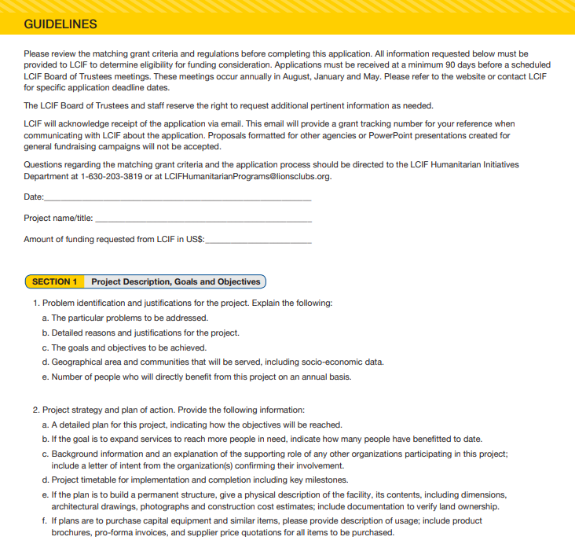
APPLICATION
BEST
PRACTICES
Notes:
Each of our different program applications has slightly different questions. Overall, they are relatively similar but please make sure you are reviewing the correct application. You must answer ALL the questions unless stated otherwise.
I’ve received questions of whether the application can be submitted in narrative form or if we prefer the questions with each answer underneath. Please answer each question. It’s a lot easier on our end when there is the question and answer, so we can check off that the answer has been provided.
My recommendation is to copy all the question in a Word document and then answer question by question.
[Next Slide]

Slide 3
PROJECT DESCRIPTION, GOALS, AND OBJECTIVES
Notes:
Problem to be addressed – why is this something that LCIF should fund?
Detailed reasons – please use data, community input, anything that strengthens your case for support
If you’re purchasing a new food truck, What we are looking for is increasing numbers served or expand the services. That’s one big thing we’re looking for.
What do you hope to achieve with this project?
What we're looking for is how does this increase the quality or quantity served
Geographic area and socio-economic data. Are you serving any under resourced communities? Who is the population that will benefit from this project and why is it important.
We are looking for an unduplicated number. Don’t tell us how many meals you're serving, we want to know the number of unique individuals per year.
[Next Slide]

Slide 4
PROJECT STRATEGY
Notes:
Do NOT start your project before approval. Make sure that this project can be completed in two years.
When will the project be completed? Give us a date or timeframe.
How many more people will benefit because of this project?
If purchasing equipment, how often will it be used? We don’t want something that is only used twice a year.
[Next Slide]

Slide 5
LIONS INVOLVEMENT
Notes:
How have Lions been involved in the past? The future? Are you just providing fundraising or will there be volunteer opportunities?
How many Lions will be involved? Please give us a specific number.
[Next Slide]

Slide 6
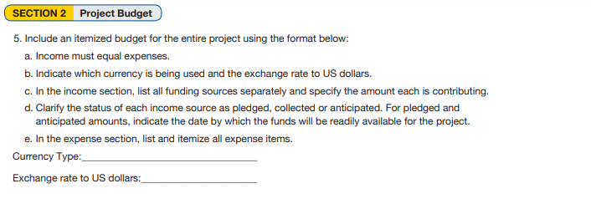
PROJECT BUDGET
Notes:
The project budget is the most informative part of the application.
The income and expenses need to match. Otherwise, staff will assume you are requesting too much money and wonder why the project requires a grant, or worse, that there is a funding gap, and the project may never be completed.
Here is how we determine if the equipment is set at a reasonable price and is appropriate for the project.
Having most or all of your matching funds collected at the time of submission tells us that there are no obstacles to having the project completed in a timely manner.
So, remind the Lions to pay close attention to the information they are providing in the budget. A well-thought-out, clear budget will reduce many questions about project goals.
[Next Slide]

Slide 7
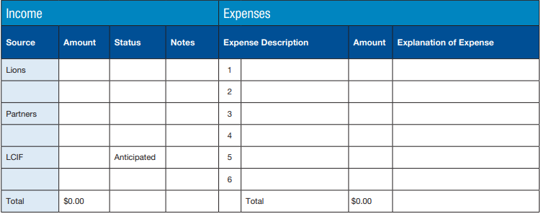
PROJECT BUDGET
Notes:
This budget should be for the total cost of the project. Whatever will be funded by LCIF and the local match.
This budget is what LCIF goes by for funding, if a cost increases in the future that will be the responsibility of Lions to cover.
Does this project have the involvement of more than one club? Aside from our Community Impact grants, all LCIF grants are awarded to the district or multiple district. We do not offer single club projects. At least two clubs must contribute to fundraising. We prefer for the amounts to be somewhat equal. That is an area our current Board of Trustees is going to focus on.
In the budget, you must list how much is being contributed by each club. If the district or multiple district is contributing, indicate that.
Maybe clubs have worked on fundraising events together – that’s great but please indicate that in the budget.
If you’re working with a partner organization and they are contributing to fundraising that’s great, but Lions are responsible for raising at least half of what LCIF is being asked to contribute.
So if you’re applying for a $100,000 Matching grant, then Lions would need to put forward at least $50,000 and the partner organization could contribute the other $50,000. Partner organizations CANNOT be responsible for the full local match.
[Next Slide]

Slide 8
Notes:
Section 3 – Key Contacts
Include contact information for whoever should be cc’d on all communications with LCIF. This should always include the District Governor or Council Chairperson
We will not communicate solely with partner organizations. They can be included on email chains, but Lions need to have a strong understanding and inclusion in the project.
Section 4 – Application Endorsement
This is meeting minutes approving the application from the cabinet or council
Endorsement from the District Governor or Council Chairperson
[Next Slide]

Slide 9
APPLICANT RESOURCES & INFORMATION
Grants Toolkit: lionsclubs.org/grantstoolkit
Grant deadlines: October 1 || February 1 || May 1
Email Global Grants: EUROPEGlobalGrants@lionsclubs.org
Notes:
More information on grants and application forms can be found on the website in the grant's toolkit, which is located under the heading “Explore Our Impact.”
Applications can be sent to the Europe Global Grants mailbox. To give ample time to review the application, ask additional questions, and provide our suggestions for strengthening the proposal, applications should be submitted by the grant deadline.
[Next Slide]

Slide 10
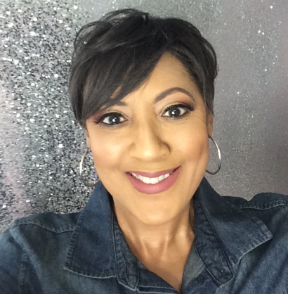
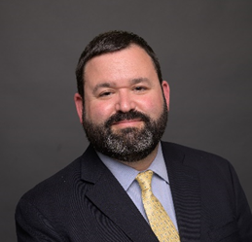
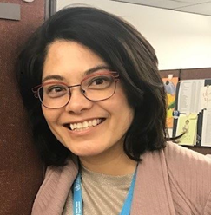
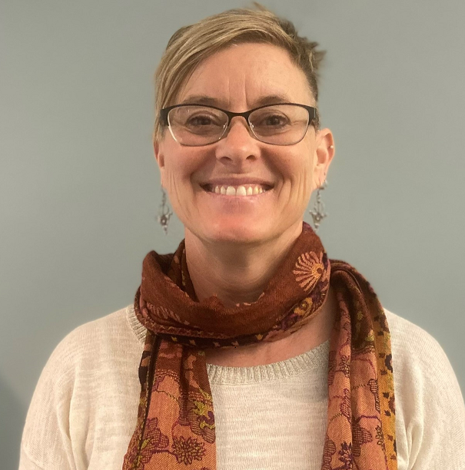
GLOBAL GRANTS EUROPE
KaSondra Byrd
Division Manager
Benjamin Futransky
Department Manager
Julie Boonprasarn
Senior Grants Specialist
Cheryl Marshall
Grants Specialist
EuropeGlobalGrants@lionsclubs.org
Notes:
About two years ago, LCIF restructured how we review grant applications. Where we used to divide the work by Global Cause, we now focus on geographical area. The goal is to direct staff resources where needed the most, and we’ve been cross-training staff on all grant types.
Specialists are knowledgeable about all grant types. We take a team approach and attempt to respond as quickly as possible. I work with Cheryl Marshall and Benjamin Futransky is manager, and our Division Manager is KaSondra Byrd.
[Next Slide]

Slide 11
THANK YOU!

