Slide 1
OUR FOUNDATION OUR IMPACT
Presenter
Presenter Title
Notes:
Hello! Thank you for inviting me to join you today for the Europa Forum. And thank you for serving your communities and supporting Lions Clubs International Foundation, or LCIF – OUR foundation. As most of you know, (introduce self)
First, I would like to introduce a special message from LCIF Chairperson Dr. Jung-Yul Choi who unfortunately could not be here today due to the COVID-19 travel restrictions in Korea.
(next slide)

Slide 4
Since
1968
US$1.1
billion
Notes:
Thank you Chairperson Choi.
LCIF gives support to clubs serving communities around the world. And the results are life-changing for so many people. LCIF provides grants for large-scale projects that clubs can’t do alone.
Since 1968, LCIF has awarded more than 1.1 billion U.S. dollars in grants! Just think about the millions of lives Lions have changed through these grants.
Quite simply, our Foundation changes lives around the world.
(next slide)

Slide 5
100%
of donations
support those in need
Notes:
As you know, the ability to award grants takes funding. Generous Lions like you continue to fund LCIF each year. 100% of each donation goes directly back into our communities to support those in need!
(next slide)

Slide 6
LCIF: HELPING HUMANITARIANS ROAR
Notes:
With every donation returned in the form of grant programs and funding, Lions Clubs International Foundation – YOUR foundation – amplifies every hour you commit to your community’s well-being. Lions and Leos worldwide have long told their moving stories of service. Now, it’s time to magnify LCIF’s impact on that service – the stories YOUR donations make possible. Let’s look at how LCIF magnified your service over the past year.

Slide 8
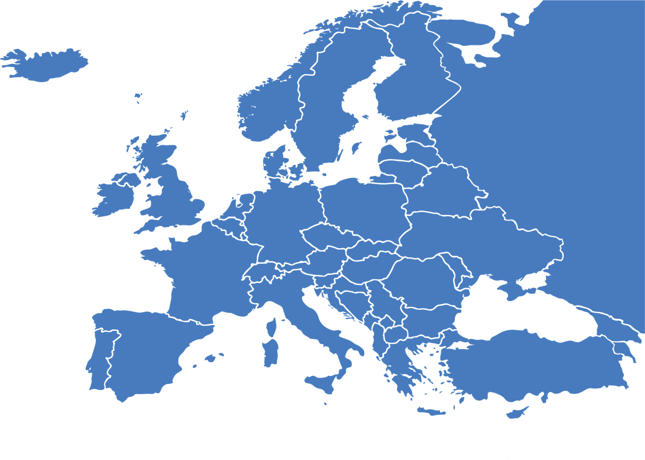
SINCE 1968
CONSTITUTIONAL AREA IV:
▸1,600+ grants ▸US$76 million
Notes:
(Insert commentary about video)
Lions, did you know since 1968, LCIF has awarded more than XX million U.S. dollars to Constitutional Area 4?
I know each dollar has been put to great use improving our beloved communities!

Slide 9
GRANT AWARDS BY CAUSE AREA 2020-2021 (US$)
Notes:
Last year alone, our global foundation helped us improve health and well-being…strengthen our own communities…and protect those most vulnerable through nearly 1,200 grants totaling more than 34 million U.S. dollars.
As you see here, LCIF grants fund projects in ALL cause areas Lions care most about.

Slide 10
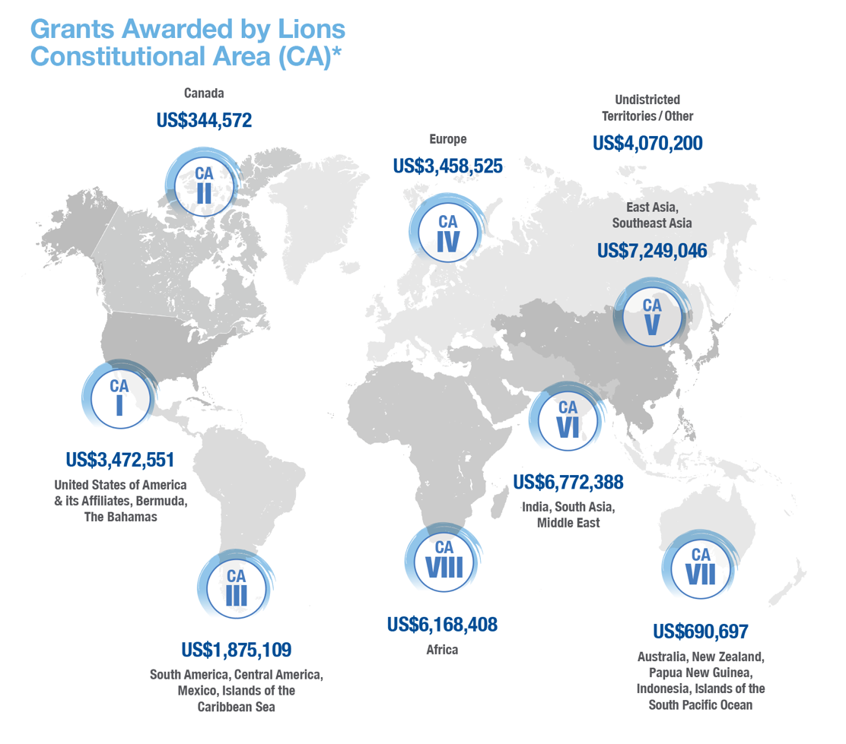
GRANT AWARDS BY CA 2020-2021
Notes:
And here is a breakdown of grants by constitutional area for last Lion year.

Slide 11
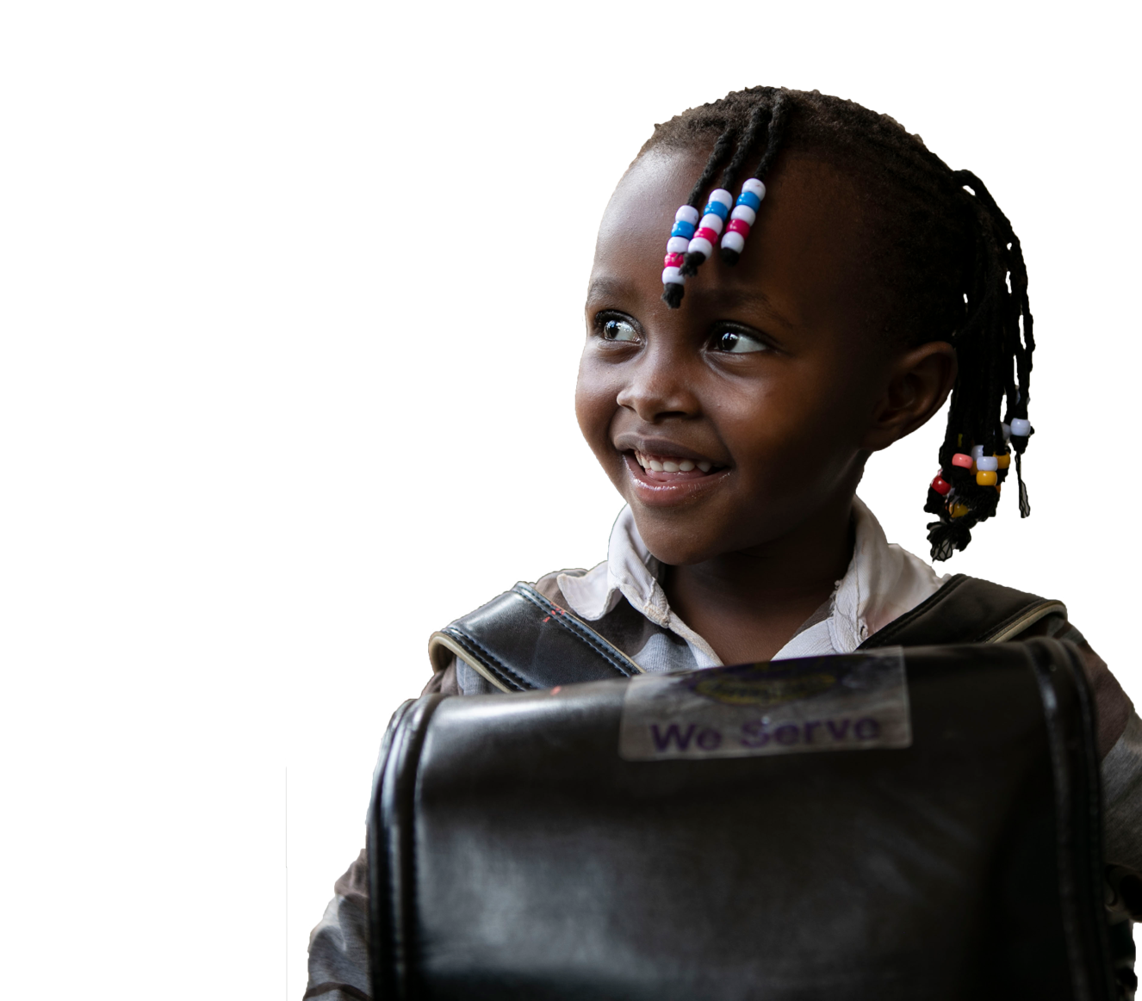
LCIF: EMPOWERING LIONS SERVICE
Presenter Name
Presenter Title
11

Slide 12
APPLICANT RESOURCES & INFORMATION
Grants Toolkit lionsclubs.org/grantstoolkit
Grant deadlines: October || February || May
10 Tips for Applying for a LCIF Grant
Email lcifglobalgrants@lionsclubs.org for more information!
Notes:
Now that we’ve talked about grant programs available, I’ll share a few resources to help you start the grant application process.
First, I hope you will take advantage of LCIF’s Grants Toolkit webpage, where you will find comprehensive information regarding applying for and managing your LCIF grant.
Next, make sure you know your grant deadlines. Most grants go to LCIF’s Board of Trustees for approval. For most types of grants, applications must be submitted 90 days prior to board meetings in order to give staff ample time to review.
Lastly, when you visit our booth, make pick up the 10 Tips for Applying for an LCIF Grant brochure, which walks you through each step of the grant application process to ensure success.
(click)
And you can always email lcifglobalgrants@lionsclubs.org for further assistance.

Slide 13
GRANT TYPES
MATCHING
DISASTER
SIGHTFIRST
DISTRICT & CLUB COMMUNITY IMPACT
DIABETES
LIONS QUEST
CHILDHOOD CANCER
HUNGER
LEO SERVICE
Notes:
As we say, where there is a need, there is a Lion. There is also LCIF, which offers a wide variety of grant programs to help you serve your community’s needs and the needs of communities around the world.

Slide 14
GRANT TYPES
MATCHING GRANTS
Help establish or expand Lions-initiated projects addressing critical human and social needs
Notes:
Let’s look at each specific grant program to see how they meet the needs of communities.
Matching grants are the most popular and can funds a variety of Lions-initiated projects addressing critical human and social needs. This includes funding construction and equipment costs for projects serving large and vulnerable populations.
(next slide)

Slide 15
GRANT TYPES
DISASTER GRANTS
Help Lions provide immediate relief; support cleanup after natural disasters
Notes:
LCIF is deeply engaged in disaster relief efforts, helping you prepare for natural disasters; respond when and where they strike; and continue relief efforts long after those from other disaster relief organizations have departed.
We offer several disaster relief grants to meet community needs at every point in the cycle.
When natural disaster strikes, LCIF can award up to 10,000 US dollars in emergency grant funding to provide immediate assistance to victims. This can include water, food, clothing, medicine, blankets, and personal necessities.
As immediate needs are met, you can apply for a Community Recovery grant to help with short-term clean-up and repair efforts. Funds can be used for things such as equipment needed for repairs and coordination of vital temporary services.
And we all know, it is not a matter of IF a disaster will strike. It is a matter of WHEN. Sadly, natural disasters are rising in number, so it is best for your community to be prepared, and you can help. Lions can apply for LCIF Disaster Preparedness grants up to 10,000 U.S. dollars to ensure their community is ready when disaster strikes.
Lastly, in the event of a major catastrophe, such as recent flooding in Europe and the earthquake in Haiti, LCIF’s chairperson and Lions international president can award a Major Catastrophe grant of more than 100,000 U.S. dollars. However, these grants cannot be applied for directly by Lions.

Slide 16
RELIEF FOR HAITI
Major Catastrophe Grant After Earthquake
US$100,000 // Haiti
7.2 magnitude earthquake followed by strong tropical storm, amid pandemic
2,100+ lives lost, 12,000+ more injured, major devastation in several cities
Lions of Sweden are shipping tents to Haiti to aid in relief efforts
Notes:
Nearly three months ago, August 14 to be exact, a massive earthquake struck the island of Haiti. 2,100 people lost their lives, more than 12,000 were injured, and 53,000 homes were destroyed. Days later the country was hit hard again, this time by a strong tropical storm affecting relief efforts, which were doubly difficult due to COVID-19.
Yet there we were. LCIF and Lions. With help from a US$100,000 LCIF Major Catastrophe grant, Lions were able to provide much needed food, water, and other emergency supplies to Haitian families in desperate need. Additionally, LCIF’s support of the Swedish Lions’ tent program enabled 200 tents to be sent to Haiti. No doubt, relief and rebuilding efforts are continuing today and will continue for months – and years.
With support from LCIF made possible by my donations and yours, Lions will be there for those in Haiti, just as they’ll be there when devastation hits our own countries. And rest assured that your donations to the disaster relief fund at LCIF will help fund relief items, such as tents, that are much needed during times of great need.

Slide 17
GRANT TYPES
SIGHTFIRST GRANTS
Help fight major causes of preventable and reversible blindness; provide services to those with blindness or visual impairment
Notes:
In 2020, LCIF celebrated 30 years of our SightFirst grant program, which has played a major role in helping restore, improve, and preserve the vision of millions of people worldwide.
SightFirst grants can be used to renovate existing infrastructure, to buy cost-effective equipment, provide comprehensive eye care service and education, and for health personnel training.
SightFirst grants submissions are closely reviewed by a team of technical advisors and must be approved through the LCIF SightFirst Advisory committee comprised of eye care professionals and Lions leaders.

Slide 18
DELIVERING A BRIGHTER FUTURE
Providing accessible eye care
US$62,729 // Paraguay
Lions Clubs of Coronel Bogado Ophthalmology Clinic
Serving rural Itapúa community
Low-cost basic eye screenings and care
Previously limited to transportable equipment
Through LCIF grant funding:
Permanent, modern equipment
30% annual capacity increase
3,400 consultations per year
Notes:
Not long ago, eye care was inaccessible, and often unaffordable, to many in Paraguay’s rural Itapúa community. In 2018, Lions began changing that, helping to fund and bring to life, Lions Club of Coronel Bogado Ophthalmology Clinic.
Since opening, the clinic provided low-cost basic eye screenings and care to residents of the area’s poorest communities, with an ophthalmologist travelling to the clinic periodically with his own equipment. But services were sporadic, and patients needing further evaluation were referred to a more comprehensive clinic in Asunción – five hours away. Because the clinic was equipped to provide only basic eye examinations, patients suffering with pain or vision loss due to issues such as diabetic retinopathy, glaucoma, or macular degeneration, were left without answers.
With nearly 63,000 U.S. dollars in LCIF grant funding, Lions seized the opportunity to equip the clinic, making more extensive, permanent care accessible close to home. Today, the clinic has modern equipment for diagnosing refractive errors, cataract, diabetic retinopathy, glaucoma, macular degeneration, and pediatric eye diseases. The new machines and technology are helping increase patient capacity 30 percent annually over 60 months, to more than 3,400 consultations a year. Service is delivered by a full-time ophthalmologist provided by the Ministry of Health and Paraguay’s national vision committee, and whose salary is paid by the government.
In addition to developing and delivering an eye health education program for the clinic, Lions help keep costs low and fund the cost of care for those unable to pay. Patients needing treatment beyond Lions clinic’s capability are referred to the clinic in Asunción, with Lions funding transportation and care for those who cannot afford the cost. Affiliated hospitals provide accommodations and meals for the patients.

Slide 19
GRANT TYPES
LIONS QUEST GRANTS
Help implement and promote Lions Quest – LCIF’s youth development program, which focuses on creating healthy school environments and empowering young people to make healthy decisions
Notes:
In 2020, LCIF celebrated 30 years of our SightFirst grant program, which has played a major role in helping restore, improve, and preserve the vision of millions of people worldwide.
SightFirst grants can be used to renovate existing infrastructure, to buy cost-effective equipment, provide comprehensive eye care service and education, and for health personnel training.
SightFirst grants submissions are closely reviewed by a team of technical advisors and must be approved through the LCIF SightFirst Advisory committee comprised of eye care professionals and Lions leaders.

Slide 20
GRANT TYPES
DIABETES GRANTS
Help reduce prevalence of diabetes and improve quality of life for those diagnosed
Notes:
Diabetes is steadily rising; there were 108 million people with diabetes in 1980. Today, there are approximately 463 million adults living with the disease, up from 422 million just 7 years ago.
To help achieve the best possible outcomes, LCIF enhanced its Diabetes grant program to deepen its commitment to large-scale or affiliate projects. Multi-year grants enable you to scale up efforts that expand and enhance diabetes education, prevention, and treatment.

Slide 21
FIGHTING DIABETES IN EUROPE
Bulgaria Against Diabetes
US$104,976 // Bulgaria
Comprehensive project to fight diabetes across country
Train nurses and diabetes coordinators
Organize 4 youth camps
Screen 20,000 people in 2 years
Notes:
Another grant and project I want to highlight is for Bulgaria. This is a comprehensive project addressing several intervention areas that fall under the diabetes grant program.
You see the sizable grant amount – more than 100,000 U.S. dollars! With the funds, Lions plan to train more than 100 diabetes coordinators and 1,000 school nurses in order to form a network of diabetes ambassadors for students and families.
Once the network is in place, Lions will help run four youth camps for children with type 1 diabetes, similar to the camp in the previous example. They also plan to conduct multiple screening and awareness events so new cases of diabetes can be identified and ensure people across Bulgaria know the importance of disease prevention.
I’d like to highlight a few things that made this application for this grant successful.
After receiving expert guidance from LCIF’s technical advisor, Lions adjusted their project and application, ultimately strengthening it. The approved project focuses on training and network-building – a sustainable approach to diabetes. Lions also ensured their screening program combines education resources, a risk assessment for all participants, and direct links to referral medical facilities so participants’ can easily continue moving toward better health. These are all crucial elements of a successful diabetes project, making for a solid Diabetes grant application.

Slide 22
GRANT TYPES
CHILDHOOD CANCER GRANTS
Help support and improve quality of life for children with cancer and for their families
Notes:
One of LCIF’s newest grant programs addresses Childhood Cancer. These grants are designed to help support and improve quality of life for children with cancer and to help families navigate new challenges and uncertainty.
This unique grant program funds construction and/or expansion of infrastructure such as homes near treatment facilities, so families can stay together during a children’s treatment. Grants can also be used to create or renovate child-friendly areas at treatment facilities; or provide patient transportation, education, and recreation.

Slide 23
HOME AWAY FROM HOME
Upgrade child-parent rooms
US$150,000 // Netherlands
Princess Maxima Center
Enables parents to live in child’s room during hospital stays
Room construction, furniture, paint
Notes:
MD110 –The grant was approved for US$150,000. Princess Maxima is the largest pediatric oncology center in Europe. The project plan is to upgrade 87 parent child rooms. The rooms will consist of a parent section, and child section, connected by sliding door. Expenses include construction, furniture, and paintings for the rooms. Lions involved include Council Chairperson Paul Janmaat and PDG Bert Verplancke.
Why was this a great project? What did the Lions do to make this work?

Slide 24
GRANT TYPES
HUNGER GRANTS
Help support Lions’ service projects focused on alleviating hunger
Notes:
One of LCIF’s newest grant programs addresses Childhood Cancer. These grants are designed to help support and improve quality of life for children with cancer and to help families navigate new challenges and uncertainty.
This unique grant program funds construction and/or expansion of infrastructure such as homes near treatment facilities, so families can stay together during a children’s treatment. Grants can also be used to create or renovate child-friendly areas at treatment facilities; or provide patient transportation, education, and recreation.

Slide 25
GRANT TYPES
LEO SERVICE GRANTS
Help support Leos in assessing, planning, implementing their service projects
Notes:
LCIF supports Leos by providing grant opportunities for local service projects. This direct funding is a way to motivate our global network of young, service-minded volunteers to act as catalysts of positive and sustainable change.
These grants encourage Leos to participate in more impactful service projects, addressing unmet humanitarian needs in their community, and exposes Leos to valuable and transferable leadership and life skills.

Slide 26
SPREADING SMILES 2.0 A Day When No Child Sleeps Hungry US$2,500 // India
Food insecurity is a main reason for society’s underdevelopment
Leos planned food distribution event; VP Dr. Patti Hill chief guest
500+ volunteers
400+ Leos, 50 Lions, and 40 additional volunteers cooked and packaged food
2,600+ children were given food boxes in 9 areas of Kolkata and Howrah
26
Notes:
I also want to highlight a project completed by Leos.
Food insecurity is a major issue facing India today and is cause for underdevelopment in society.
Leos in District 322B1 took on the challenge of hunger, which affects many children throughout Kolkata and Howrah in West Bengal, India.
Supported by a US$2,500 Leo grant, nearly 500 Leos, Lions, and other volunteers, along with Chief Guest Vice President Dr. Patti Hill, cooked, packaged, and distributed more than 2,600 food boxes to local children to bring smiles and ensure no child goes to bed hungry.
(Next slide)

Slide 27
DISTRICT & CLUB COMMUNITY IMPACT GRANTS
Awards vary; based on contributions to LCIF
Help support variety of local humanitarian activities
Fund broad array of service projects
Districts and clubs donating at least US$10,000 and US$5,000, respectively, to LCIF during Lion year may apply for grant up to 15% of donated amount
May also be applied to matching fund requirements for other LCIF grant programs
Notes:
District and Club Community Impact Grants (DCGs) offer the opportunity for you to support humanitarian activities in your communities. Clubs can apply to use their own DCG funds for a stand-alone project OR multiple clubs can work collaboratively and pool their DCG funds. Qualifying clubs and districts can apply for a grant equal to 15% of your total contributions that year.
To qualify, districts must donate a minimum of 10,000 U.S. dollars to LCIF per fiscal year, and clubs must donate a minimum of 5,000 per fiscal year.
DCGs are a great way for you to directly impact your community through your support of LCIF!

Slide 28
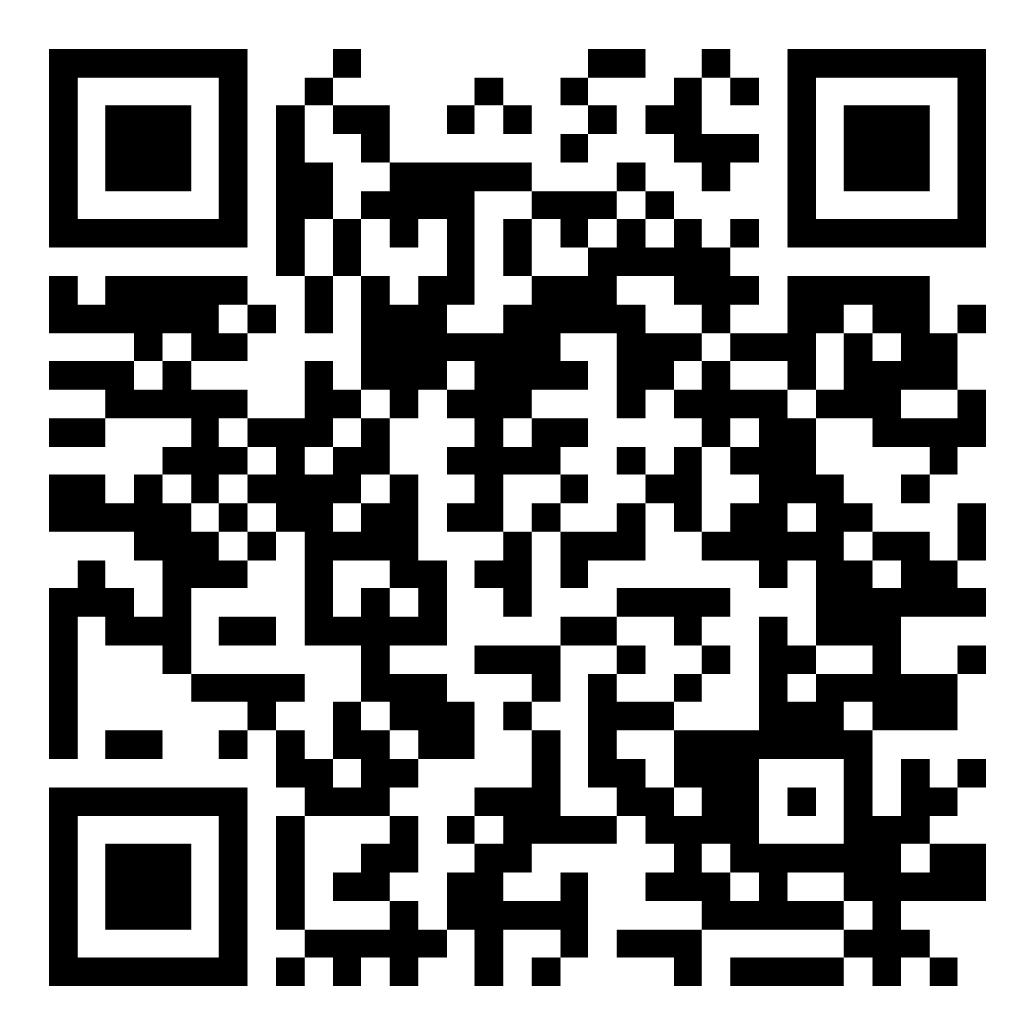
CONTACT LCIF
lionsclubs.org/grantstoolkit
LCIFglobalgrants@lionsclubs.org

Slide 29
LCIF: STORIES OF PRIDE
Presenter Name
Presenter Title
29

Slide 30
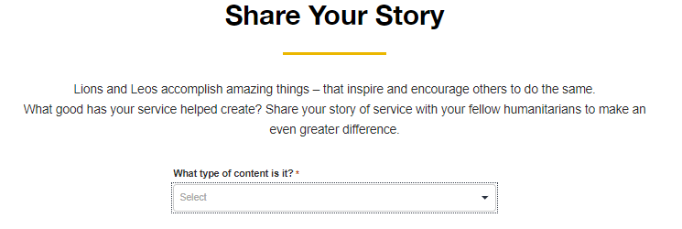
STORIES OF PRIDE
Visit lcifpride.org to submit your story today!
Notes:
LCIF wants to capture ALL these amazing stories of Lions work in your communities – magnified by the power of Lions Clubs International Foundation grants.
Earlier this year, the LCIF Marketing Department launched Stories of Pride – a new platform design to celebrate your work with stories captured and submitted by you!
By visiting lcifpride.org, you can hear from Lions around the world and submit your own story of pride.

Slide 31
A SPECIAL WEEKEND
Hosting a camp for kids
US$5,000 // Portugal
43 Leos and 17 Lions hosted a camp for 77 local children
Children were often from low-income homes or suffered from PTSD
LCIF enabled the camp to serve even more children
Notes:
Our first Story of Pride comes from Portugal where a $5,000 Leo service grant helped Leos, with the help of Lion mentors, host a camp for 77 children from eight different towns. Let’s hear more from Past Council Chairperson Nuno Alexandre Cabral Ferrão and see how Lions and Leos helped make a difference in the lives of these children.
(ROLL VIDEO)

Slide 33
RINGING THE BELL OF BRAVERY
Lions Support Global HOPE Center for Excellence
Ongoing Partnership // Botswana
Connected through partnership between Lions Clubs International Foundation and Texas Children’s Hospital
Lions of Botswana donated a “Bell of Bravery” for children to ring when they have completed treatment
Notes:
In sub-Saharan Africa, the childhood cancer mortality rate is estimated to be as high as 90 percent. In some countries, there’s a lack of care for children with cancer. In 2019, a partnership began with LCIF and Texas Children’s Hospital’s Global HOPE program, which is focused on building long-term capacity to treat and dramatically improve the prognosis of children with cancer in sub-Saharan Africa.
This is one story of the Bostwana Lions collaboration with Global HOPE. Two of these Lions and Melvin Jones Fellows, Vinay and Amsha Naicker, wanted to help make a difference in the lives of children fighting one of the most difficult diseases. See how these Lions helped instill hope in their patients.

Slide 35
CAMPAIGN 100: LCIF EMPOWERING SERVICE

Slide 36
Notes:
Now today, and for months to come, when we talk about LCIF, we’re also speaking of Campaign 100: LCIF Empowering Service.
(click)
You see, LCIF and Campaign 100 are linked just as tightly as each of us is to our community. Lions Clubs is the greatest service organization in the world, and we are here to share more about Campaign 100, the greatest opportunity in Lions history to ensure our service continues for generations!
For those already immersed in Campaign 100, thank you for your support and ongoing commitment. For those less ingrained, welcome to Campaign 100!
(next slide)

Slide 37
INCREASING Service Impact
FIGHTING
Diabetes
EXPANDING
Global Causes
Notes:
Through Campaign 100, we are increasing our service impact in vision, youth development, disaster relief, and humanitarian efforts.
(click)
Fighting the global epidemic of diabetes and improving quality of life for those diagnosed
(click)
And expanding our focus on childhood cancer, hunger, and the environment.
The needs of our world are changing rapidly and with your help, LCIF will be therewith funding to help us meet those needs.

Slide 38
US$300 MILLION
To serve our world in need. We must significantly add to our progress
Notes:
Three hundred million dollars. That’s a tremendous sum of money, but remember the WHY we just discussed. The world needs our service. Together, Lions and clubs worldwide have already helped us toward our goal. But we would not be here today if we did not need significantly more progress.
When Campaign 100 launched, our strategy meant we would reach our goal by mid-2021. The global pandemic has complicated our world, including our ability to raise funds.
(click)
For this reason, LCIF’s board of trustees approved extending Campaign 100 through June 2022. They did so with confidence that you and I, your club and mine, will take advantage of the extension to support our service by supporting our foundation!

Slide 39
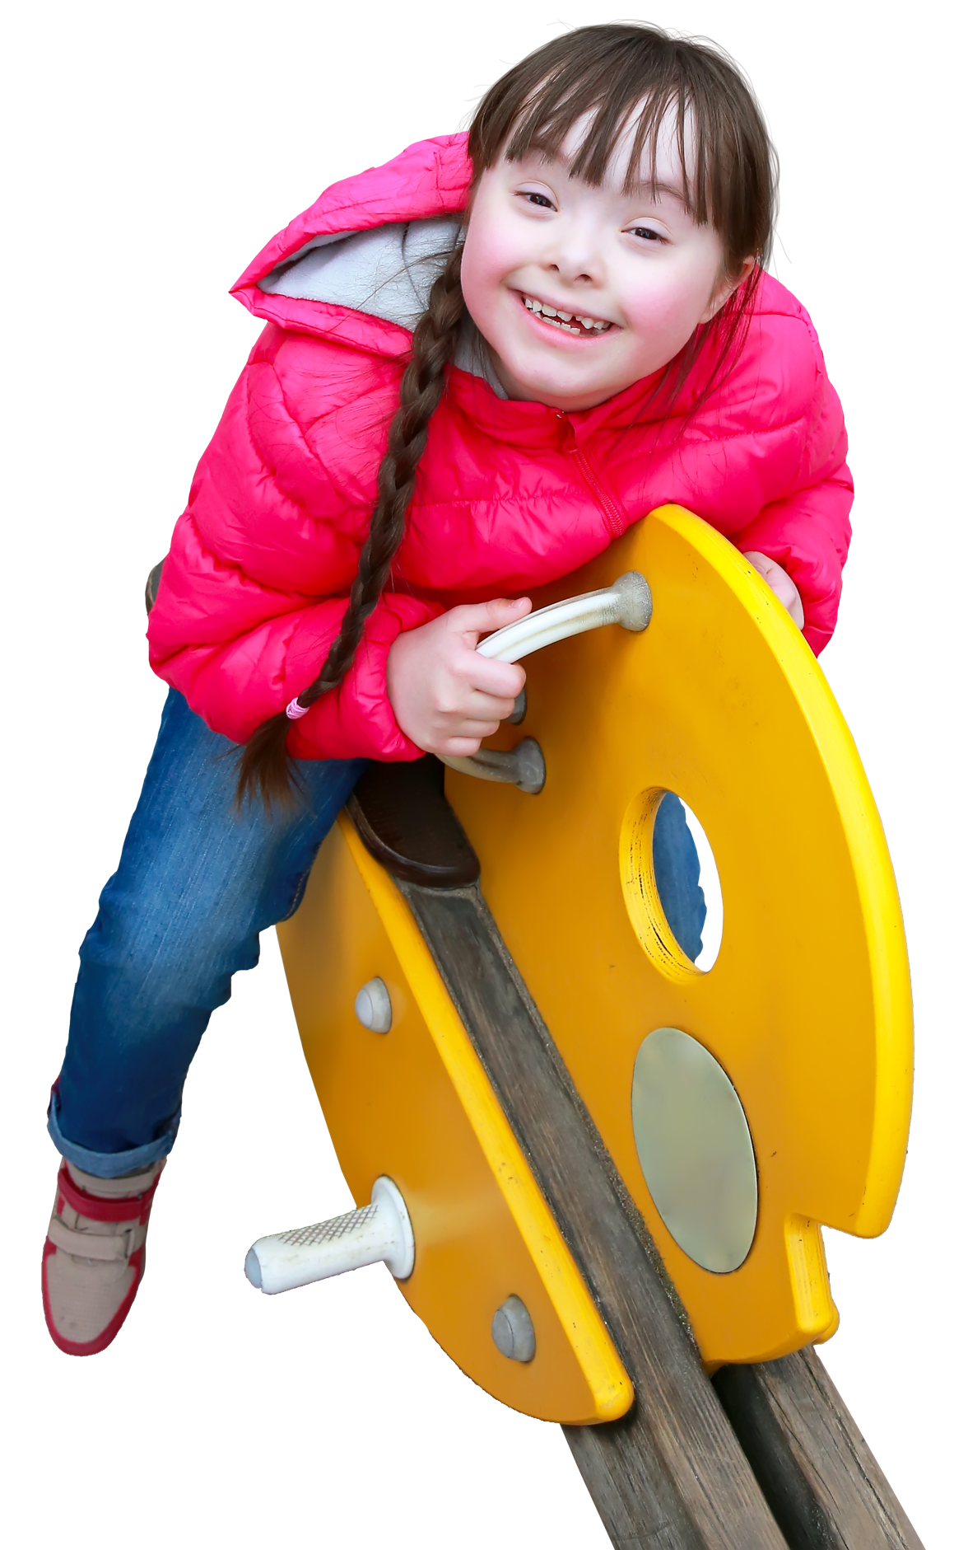
CAMPAIGN 100: WHAT WE’VE ACCOMPLISHED

Slide 40
CAMPAIGN PROGRESS

Slide 41
LCIF RESPONSE TO COVID-19
WORLDWIDE:
385 grants || US$6,846,917
CA IV:
44 grants || US$1,682,259
Because of your generosity, LCIF able award grants quickly
Purchased protective equipment for healthcare, frontline workers
Notes:
COVID-19 has drastically changed all our lives and quickly shifted how we Lions connect and serve our communities.
However, I have some great news to share with all of you on how LCIF continues to support Lion service through the pandemic.
Since March 2020, LCIF has awarded more than 6.8 million U.S. dollars for COVID-19 relief funding. This funding has purchased much need personal protective equipment and supported our local healthcare workers.
More than 1.6 million US dollars has been awarded right here in C.A. 4 bringing much needed hope, kindness, and optimism.
Thank you for looking after your neighbors on the front line of pandemic relief.
(next slide)

Slide 42
LAUNCHING NEW GRANT PROGRAMS
CHILDHOOD CANCER GRANT:
15 grants || US$851,935
HUNGER GRANT:
37 grants || US$1,552,144
Notes:
In 2019, LCIF launched two new grant programs addressing Childhood Cancer and Hunger. To date, these pilot grant programs have together awarded 52 grants totaling more than 2.4 million US dollars.
In India, Lions used a Hunger grant to upgrade kitchens and dining facilities in NINETY childcare centers throughout the state of Kerala. These improvements are helping more than 2,200 children enjoy freshly prepared meals in clean, welcoming environments.

Slide 43
LARGEST CAMPAIGN IN HISTORY
Increase Model Clubs
Increase Club and Individual donations
LCIF’s District and Club Community Impact grant program
Notes:
This year we are focusing on three initiatives to help us reach our goal of US$300 million globally, US$49 million in CA IV:​
​
With your help, we need to increase the number of Model Clubs​
We need more members to participate in our campaign. We need EVERY Lion and Leo – and club – on board!​
And we need to make sure we all spread the word of LCIF’s District and Club Community Impact grant program, which returns a portion of what we donate to LCIF to our communities in the form of grant funding. More on this wonderful grant program for your club or district in a few minutes.​

Slide 44
Grateful for your support!
When we make it personal, we give what we can.
Notes:
For those who have already personally supported LCIF during Campaign 100, thank you. For those who have made your gift recurring, or ongoing, thank you again. For those meaning to give whatever you can, I ask you to recall your answer to my question about how LCIF grant funds have PERSONALLY empowered your service. When we make it personal, we give what we can.

Slide 45
JOIN US FOR FOUNDATION FRIDAYS!
One-hour webinars hosted by the Executive Officers
Typically, on the first Friday of each month
Upcoming topics:
October & November Taking Fundraisers to the Next Level (2-part series)
December Be Recognized for Your LCIF Donations
January How LCIF Works for You
February Stories at the Heart of Service
Notes:
(PRYOR)

Slide 46
RESOURCES
Campaign 100 Resources: lionsclubs.org/campaign100
Email: campaign100@lionsclubs.org
LCIF Grant Information: lionsclubs.org/grantstoolkit
Email: lcifglobalgrants@lionsclubs.org

Slide 47
THANK YOU!
Notes:
I know there are many questions, but before we address them, I ask all of you here to remember the common thread among the stories of service – stories of pride – we heard earlier. What made each project extraordinary, even life-changing, is a combination of YOUR service empowered and magnified by LCIF grant funds.
Please, let’s all give what we can, whenever we can. Every gift makes a difference in someone’s life. We’ve entered our final year of LCIF’s Campaign 100. We each have 10 months to become part of Lions history by giving individually and through our clubs. On behalf of LCIF, I kindly ask for your support so LCIF can provide grant funds to you, Lions and Leos for decades to come.

