Slide 1
Where to find What on the Web (www)
District Goals
Real Time Dashboard and Drill-down Reports (2023)
Lionsclubs.org
New Portal
lcifday.eu
Monthly reports and recap of donations
(2023)

Slide 2
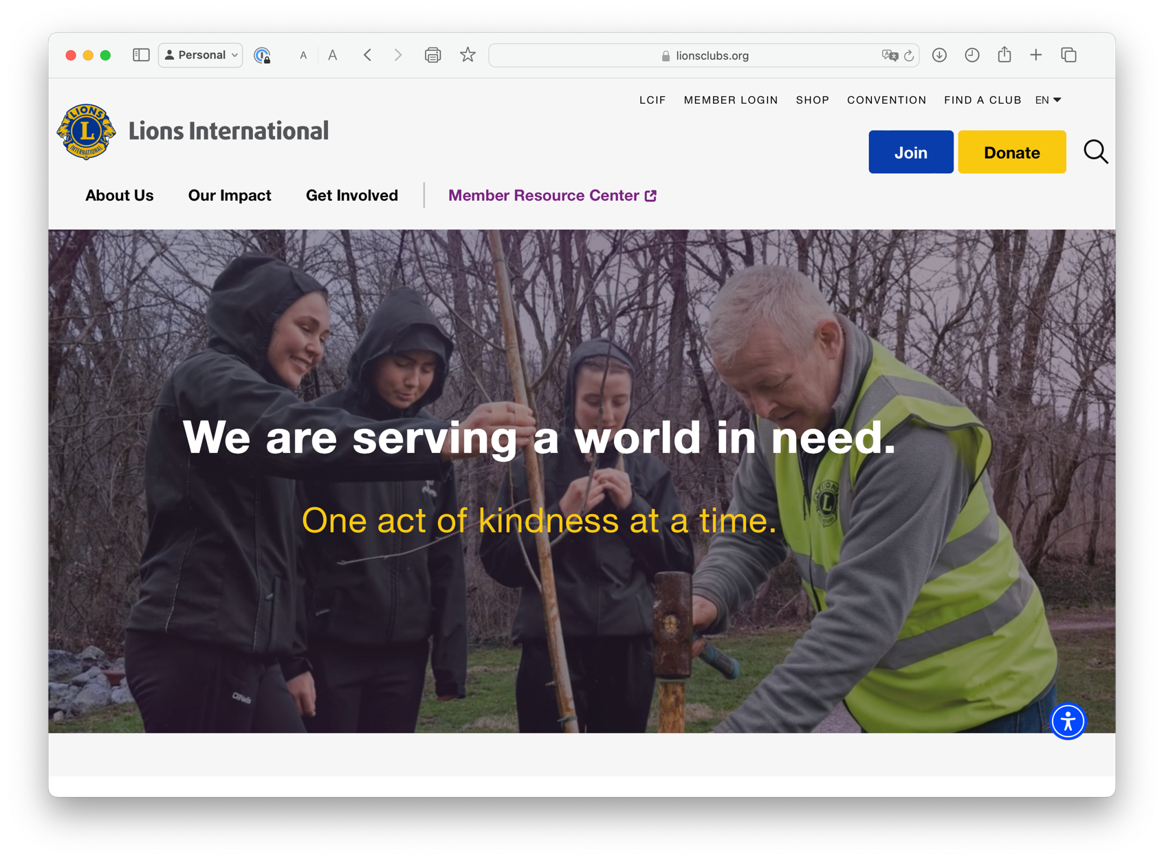

Slide 3
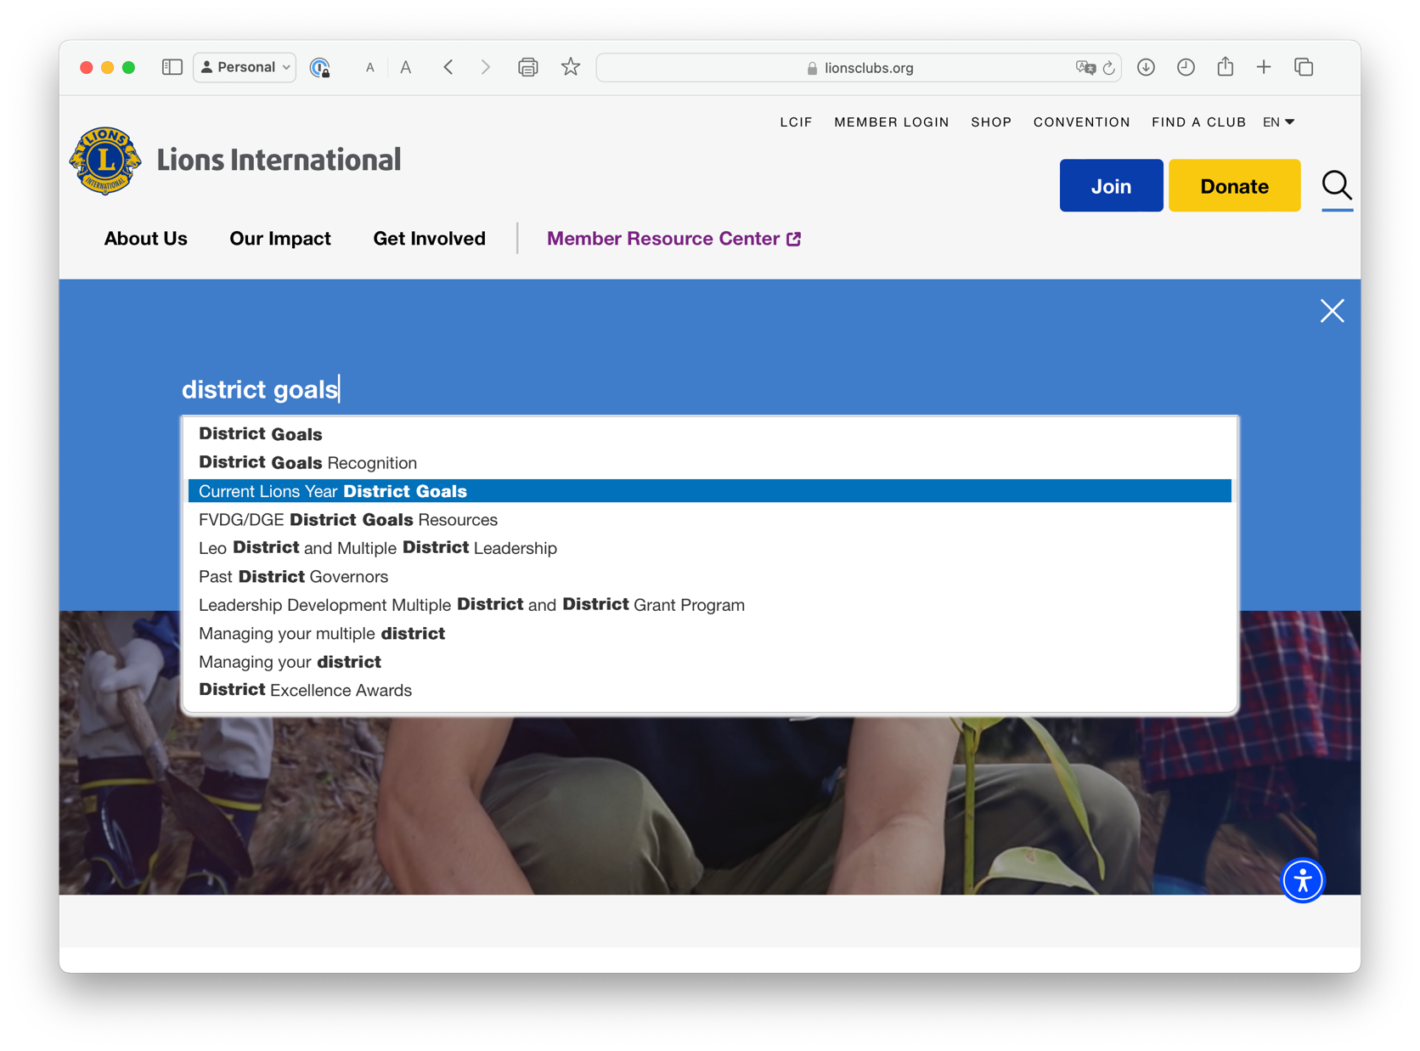

Slide 4
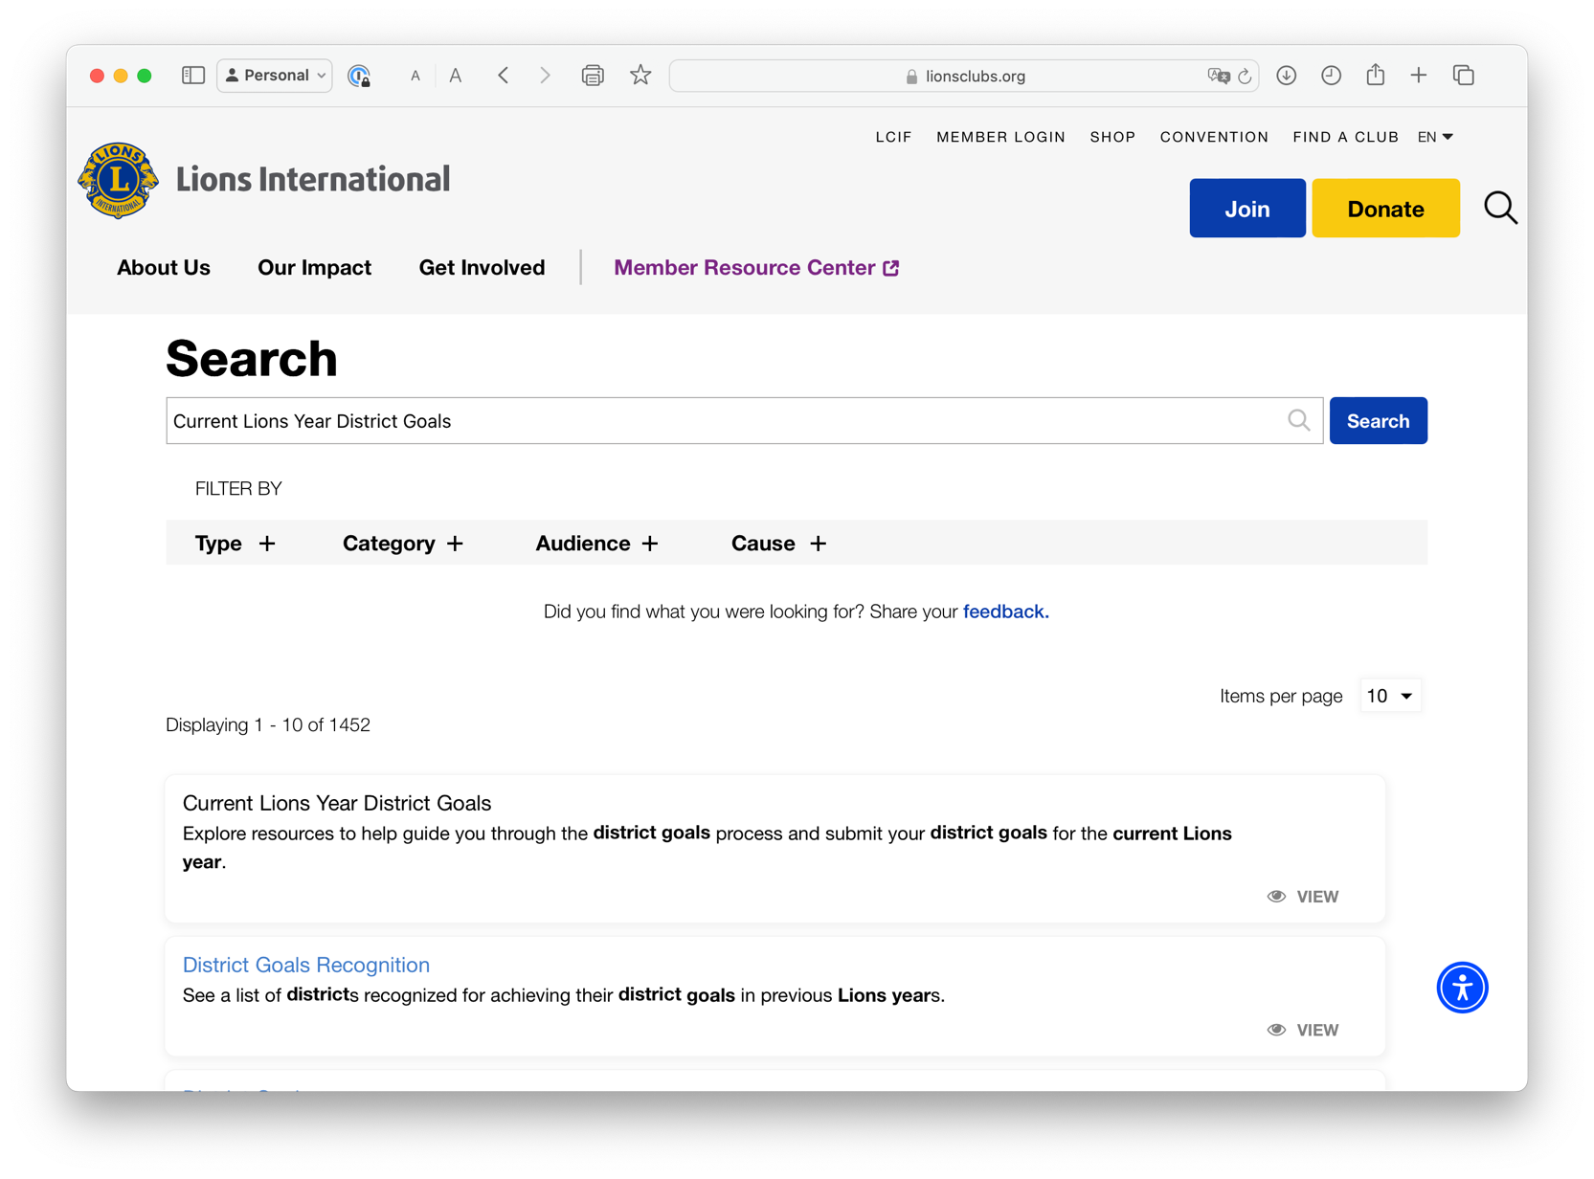

Slide 5
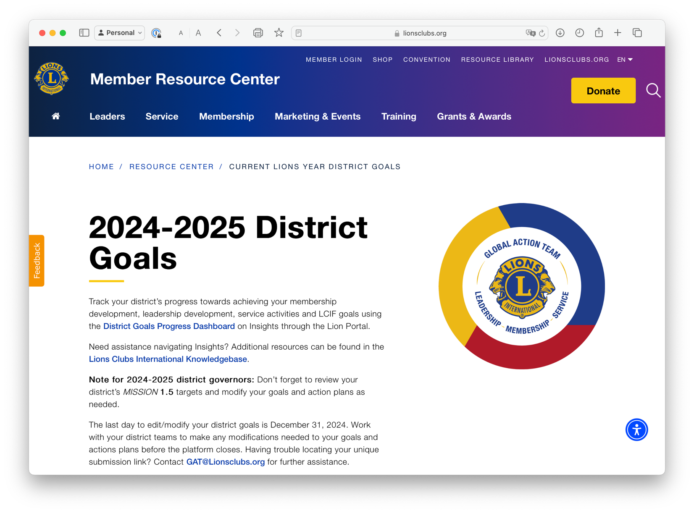

Slide 6
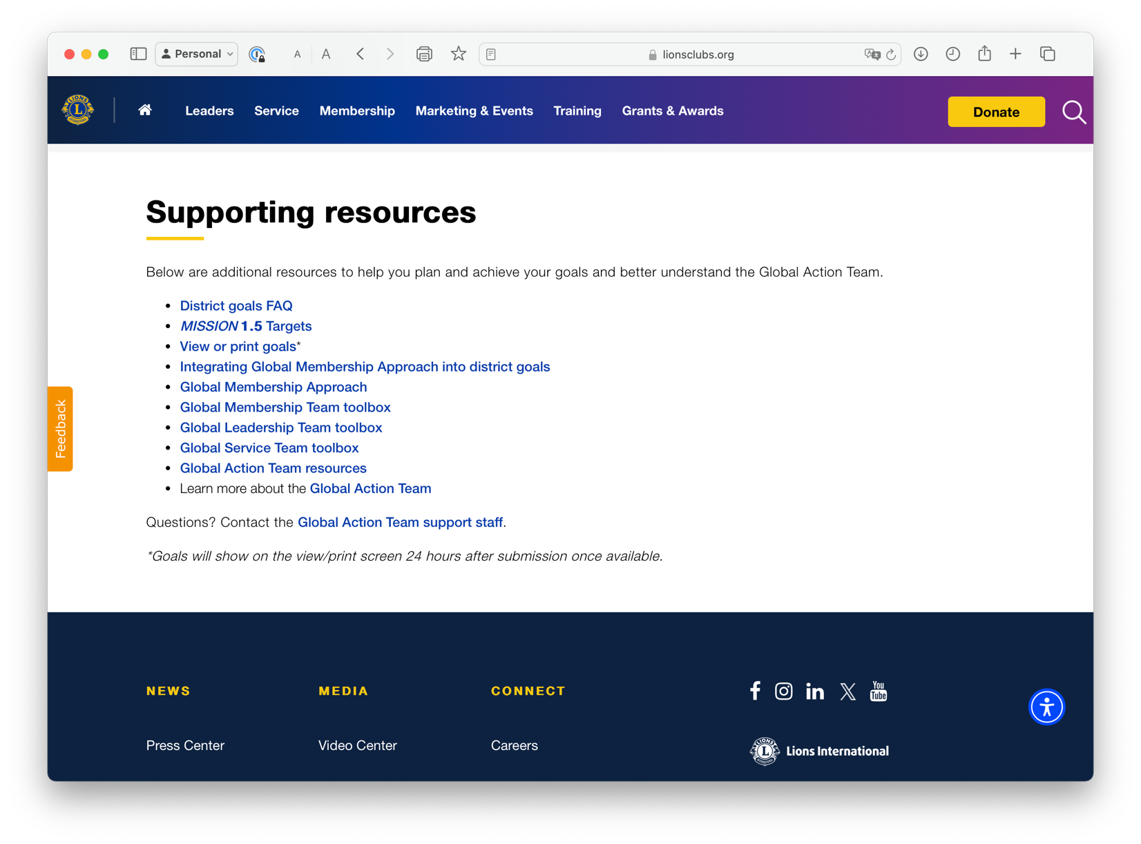

Slide 7
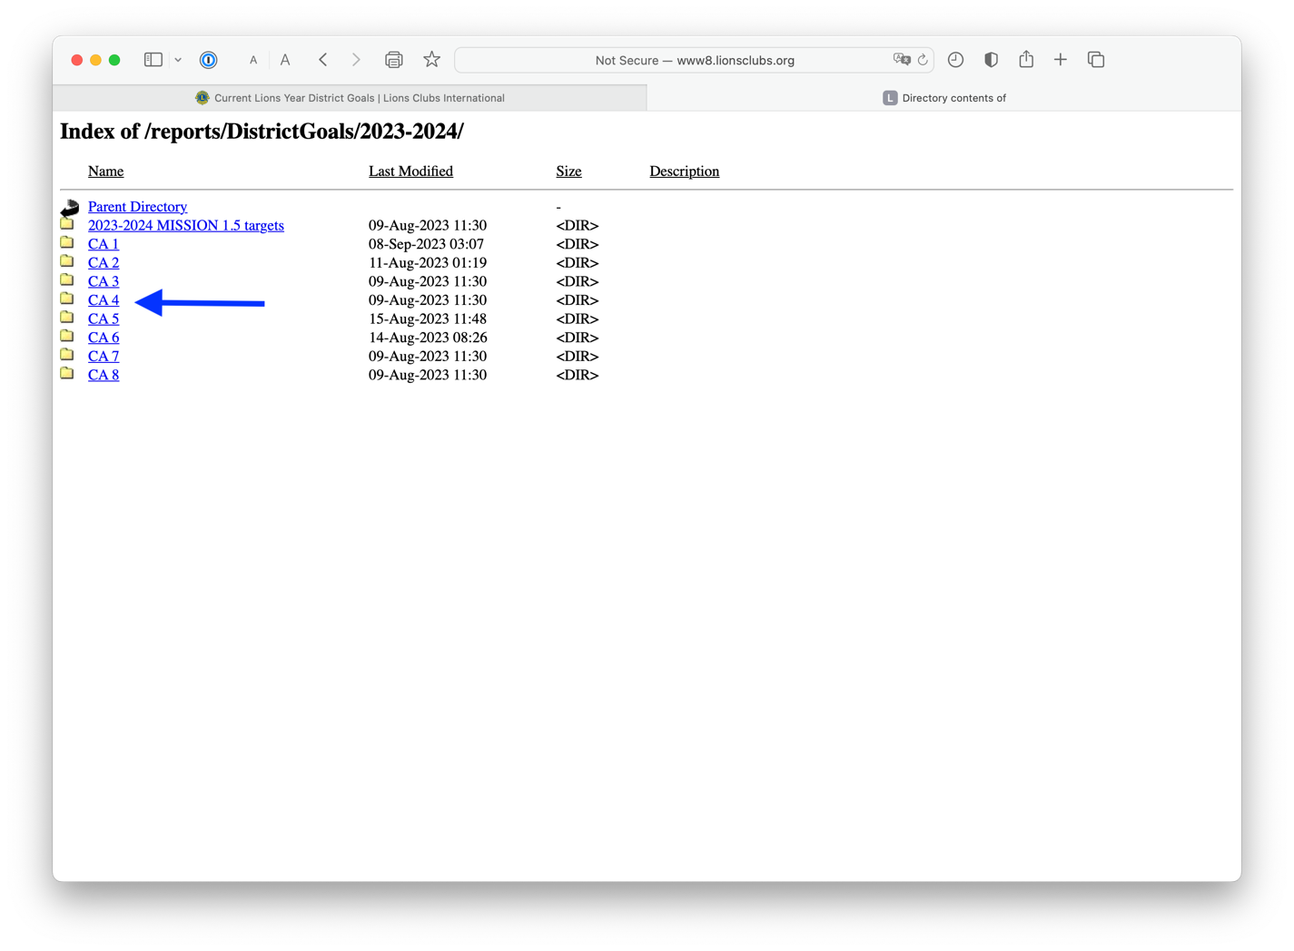
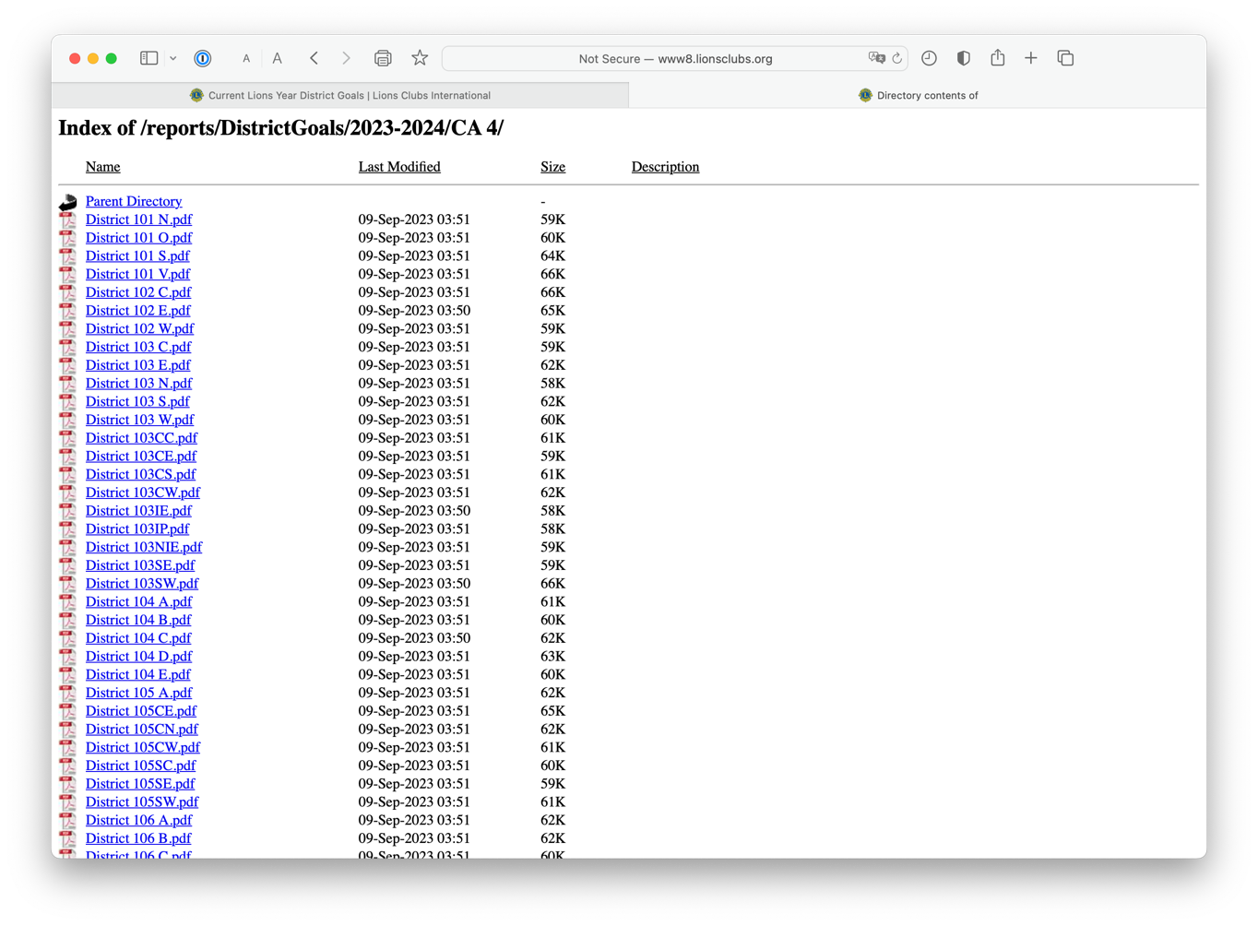
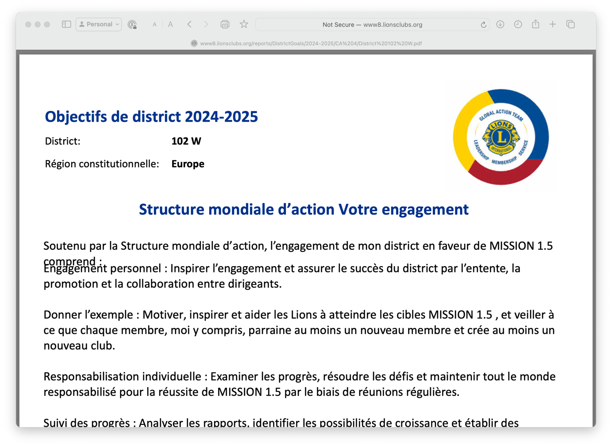

Slide 8
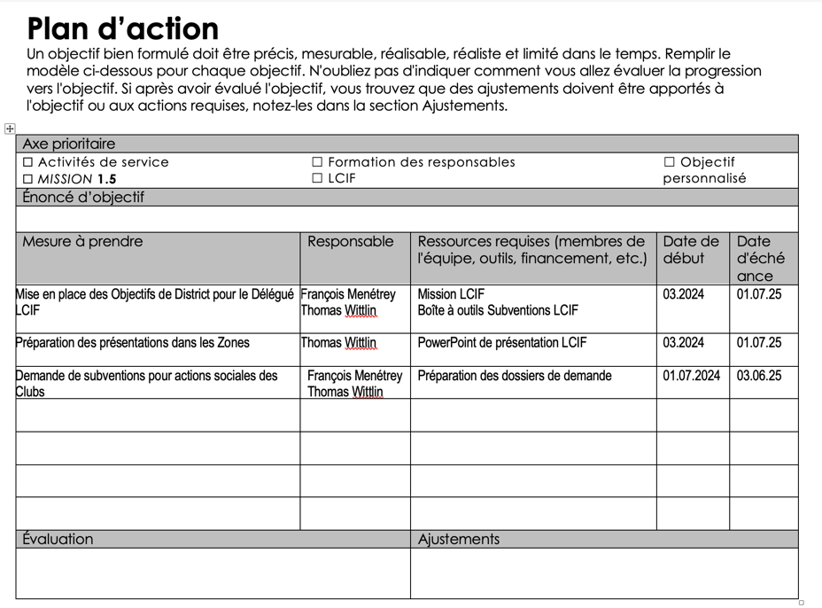

Slide 9
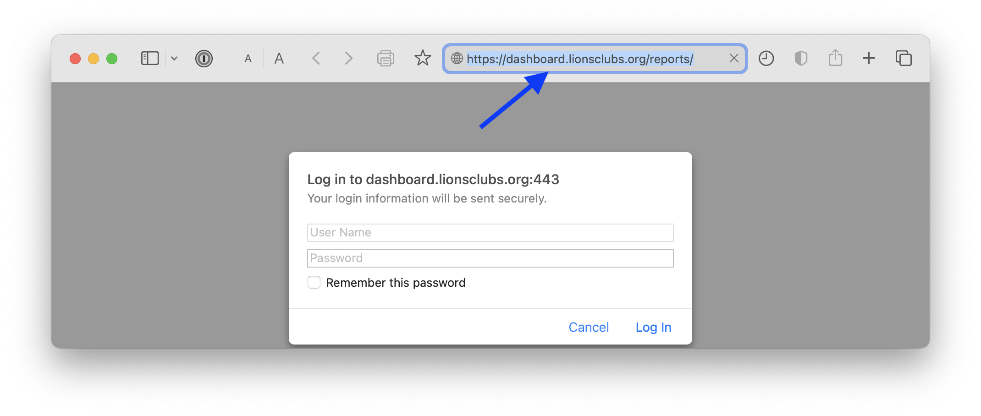
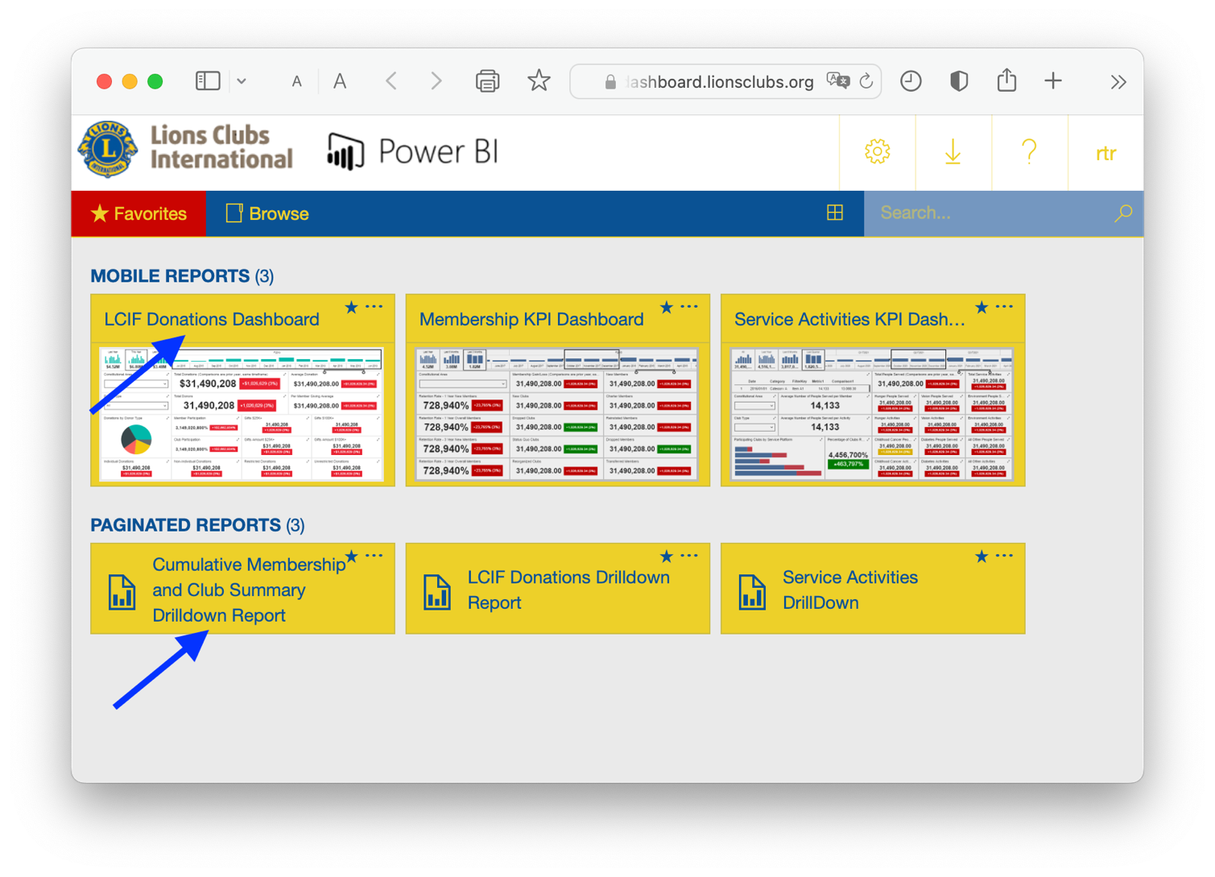
From 2023 presentation
No more necessary
(embedded in new 2024 Portal)

Slide 10
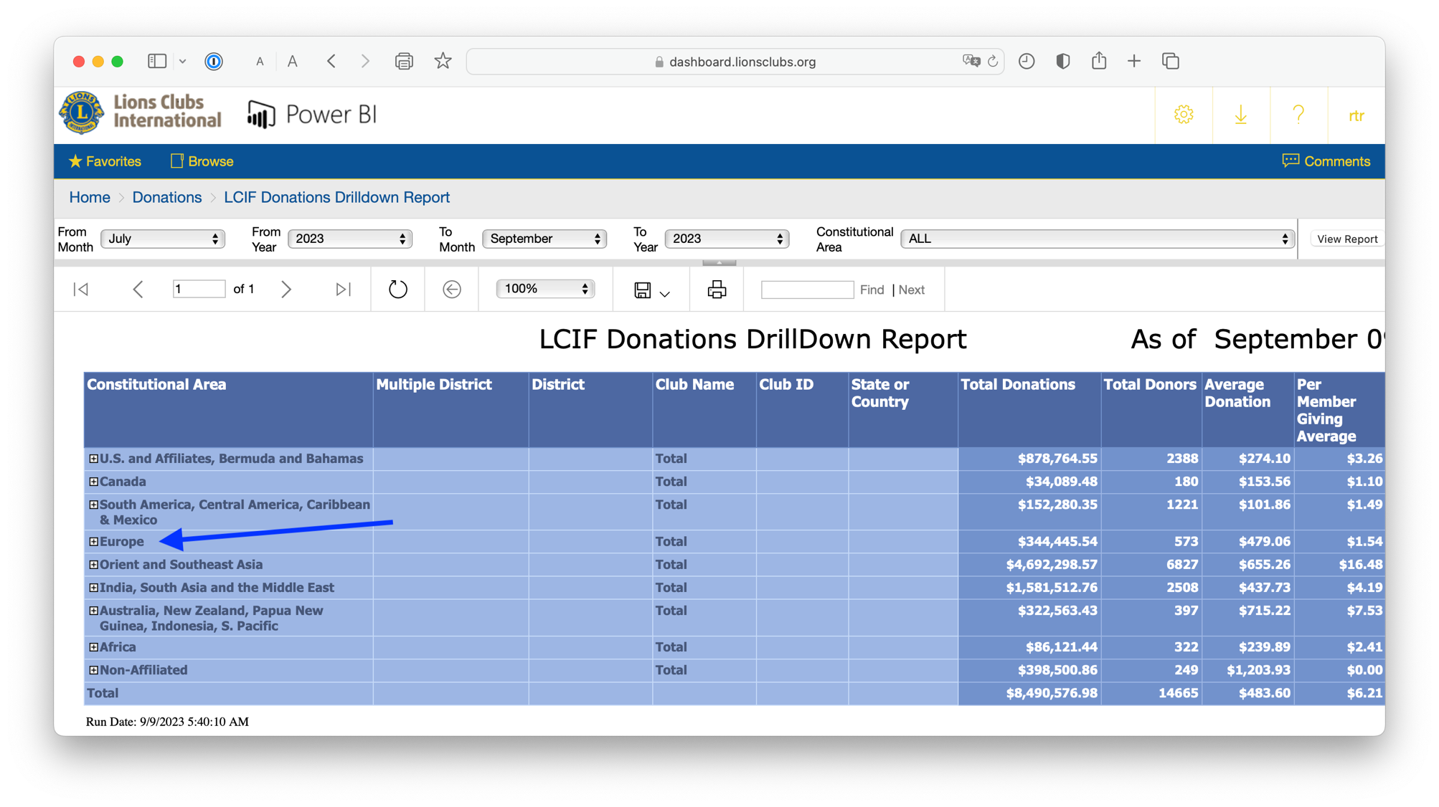

Slide 11
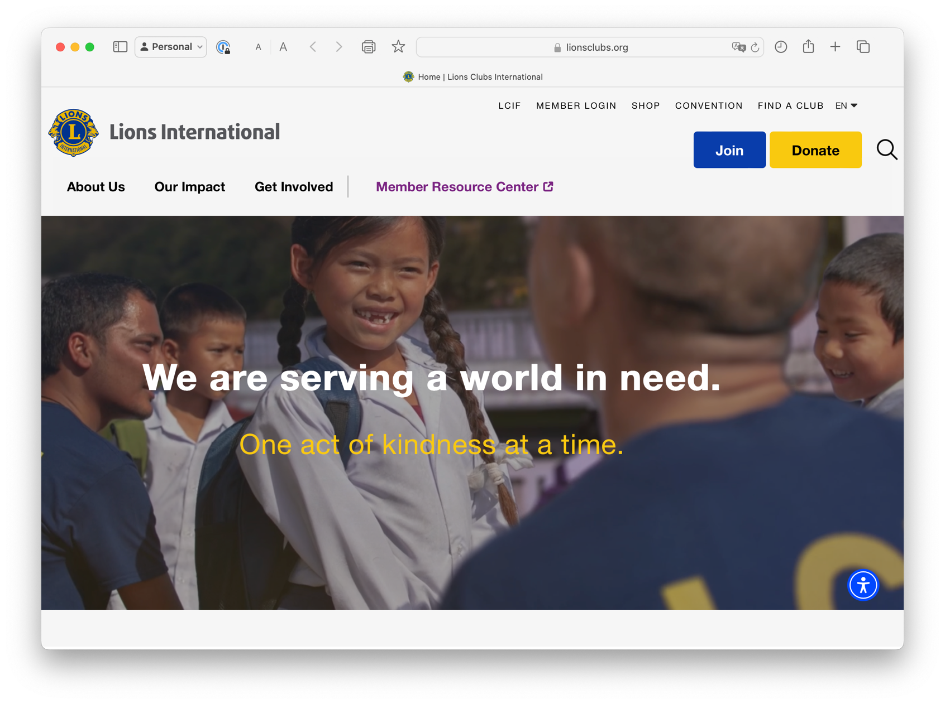
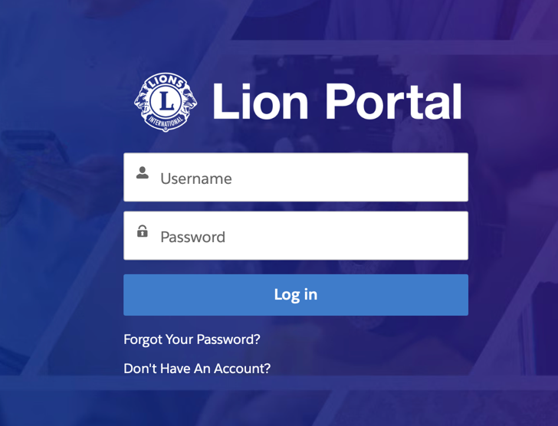

Slide 12
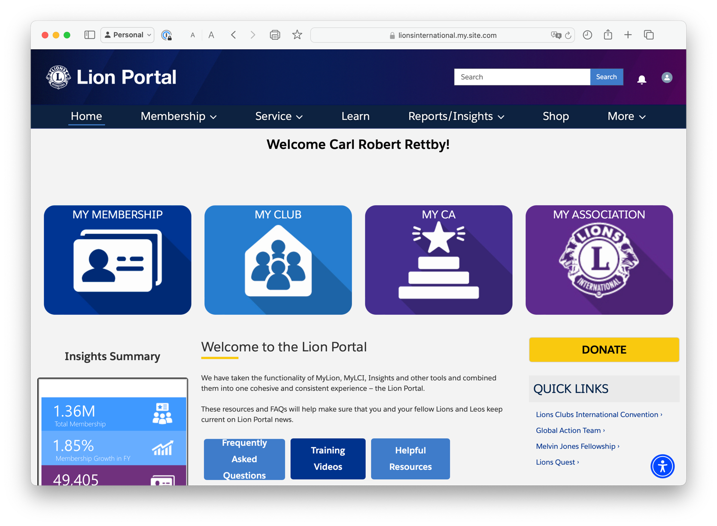

Slide 13
Notes:
Your role is stragegic

Slide 14
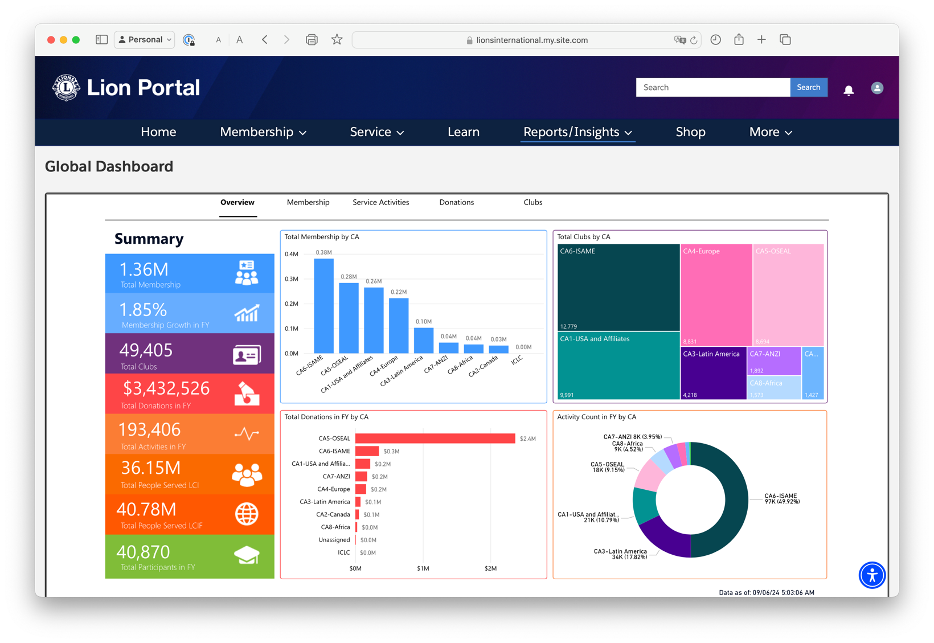
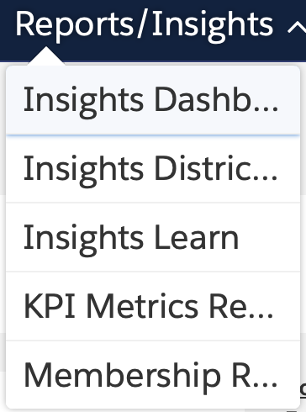

Slide 15
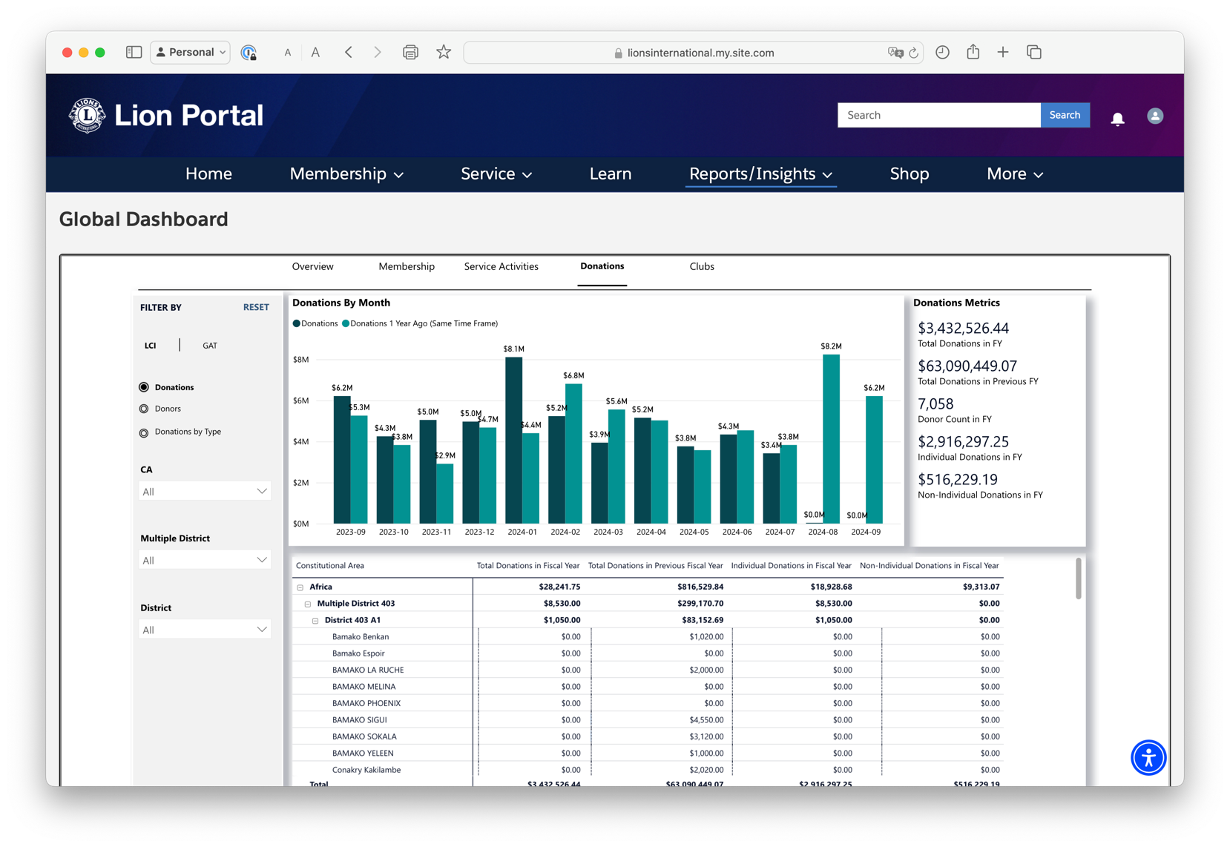

Slide 16
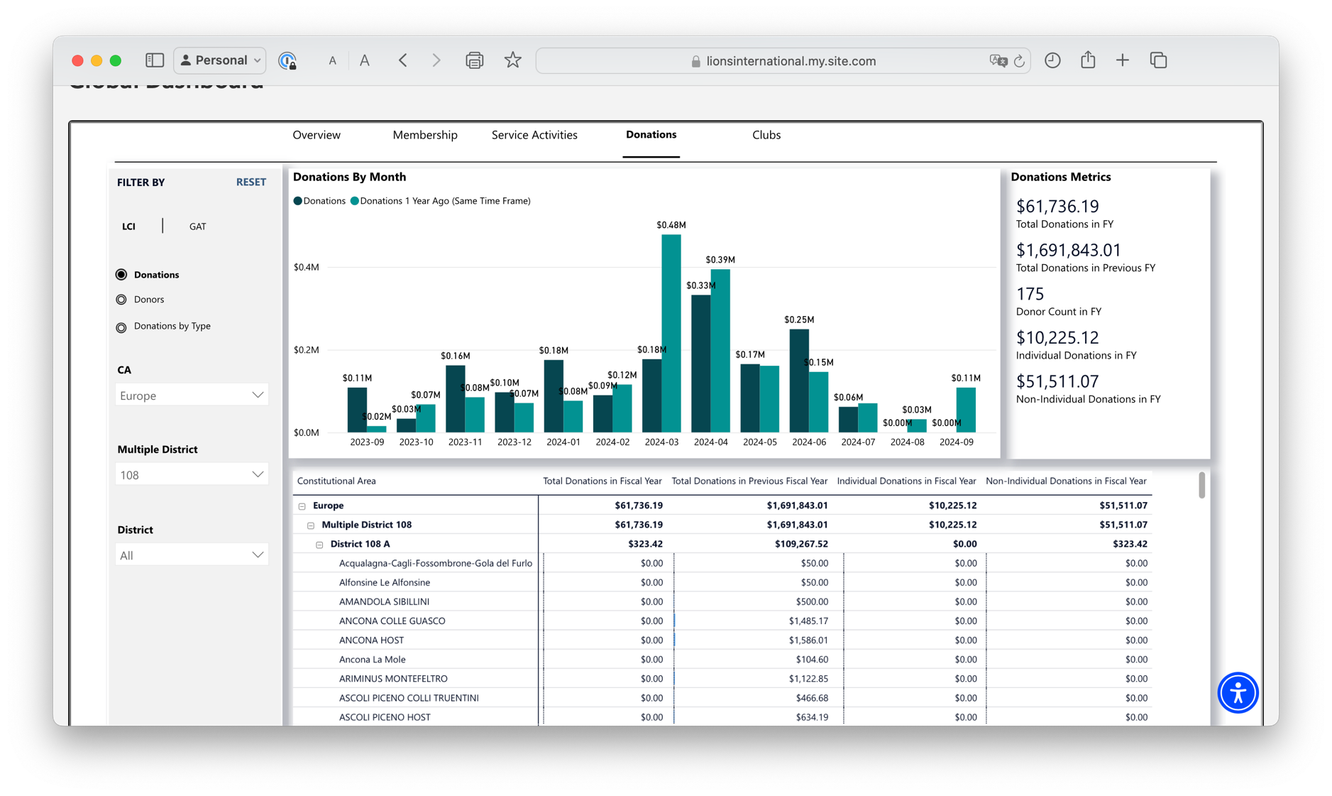

Slide 17
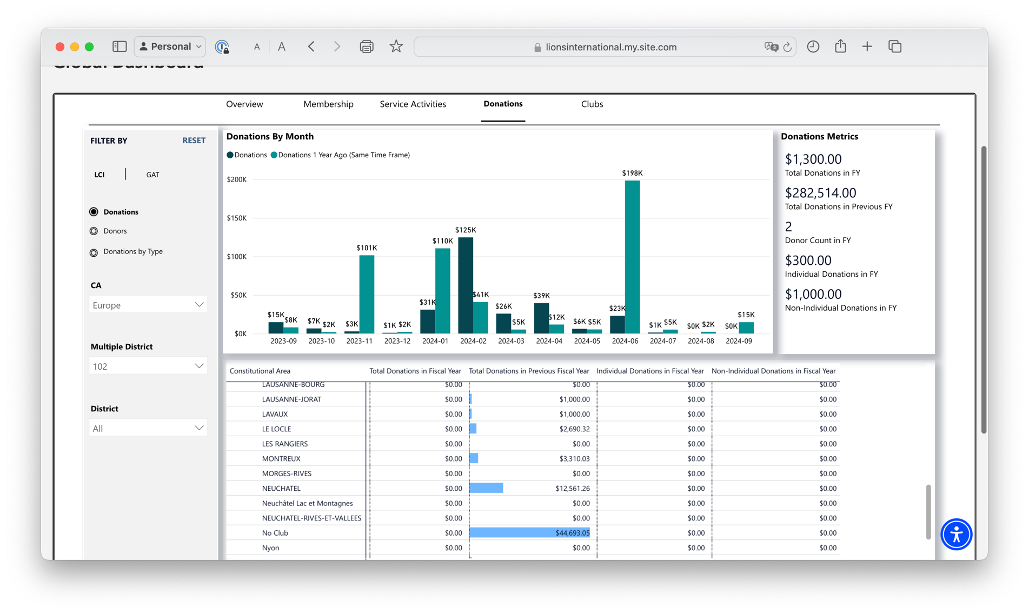

Slide 20
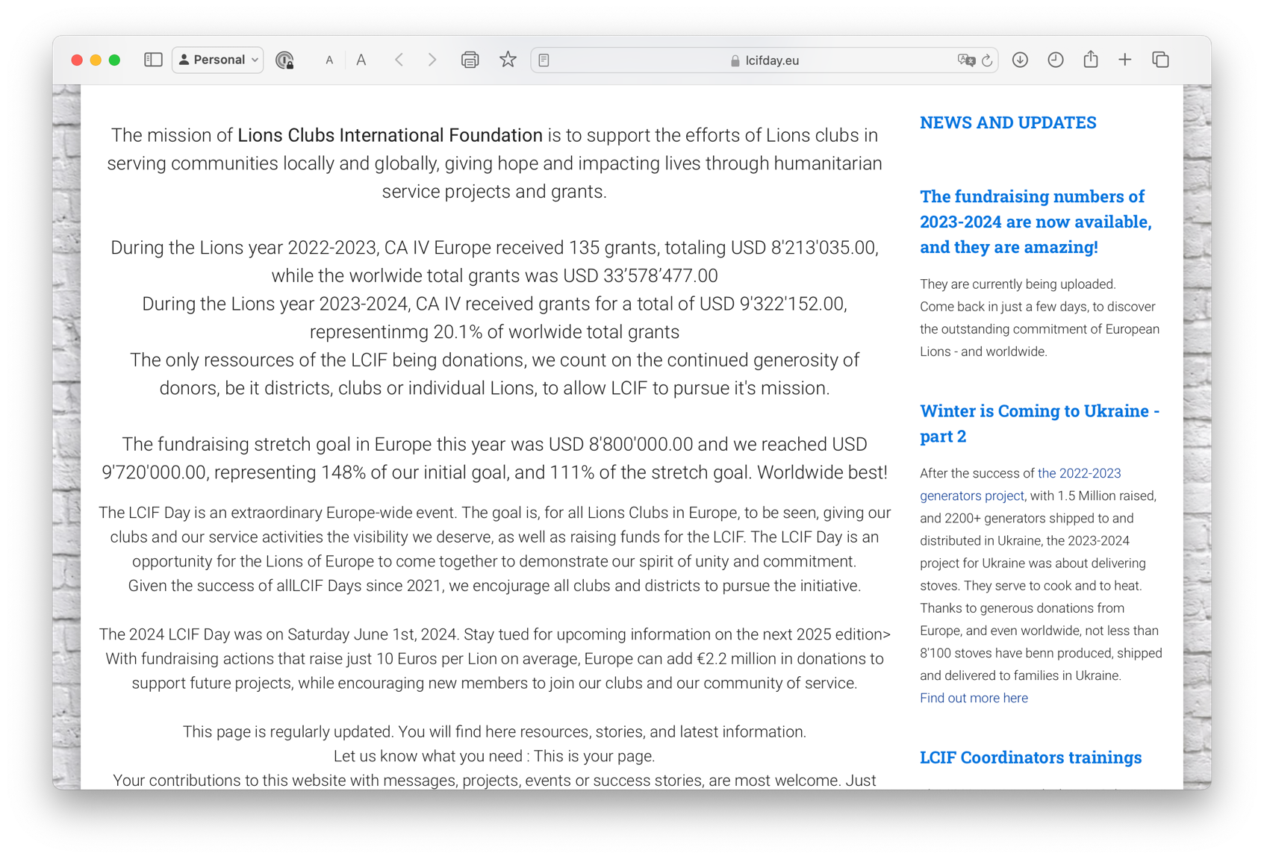

Slide 21
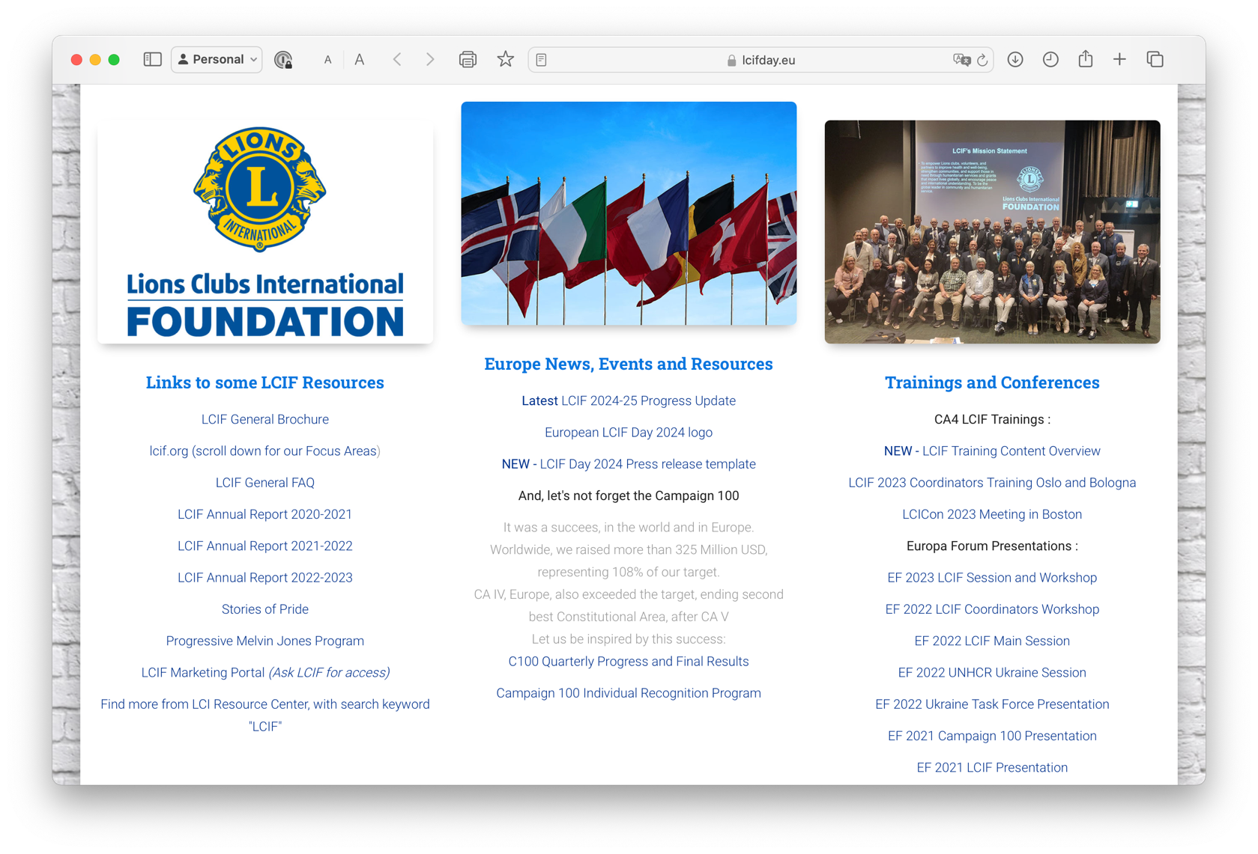

Slide 22
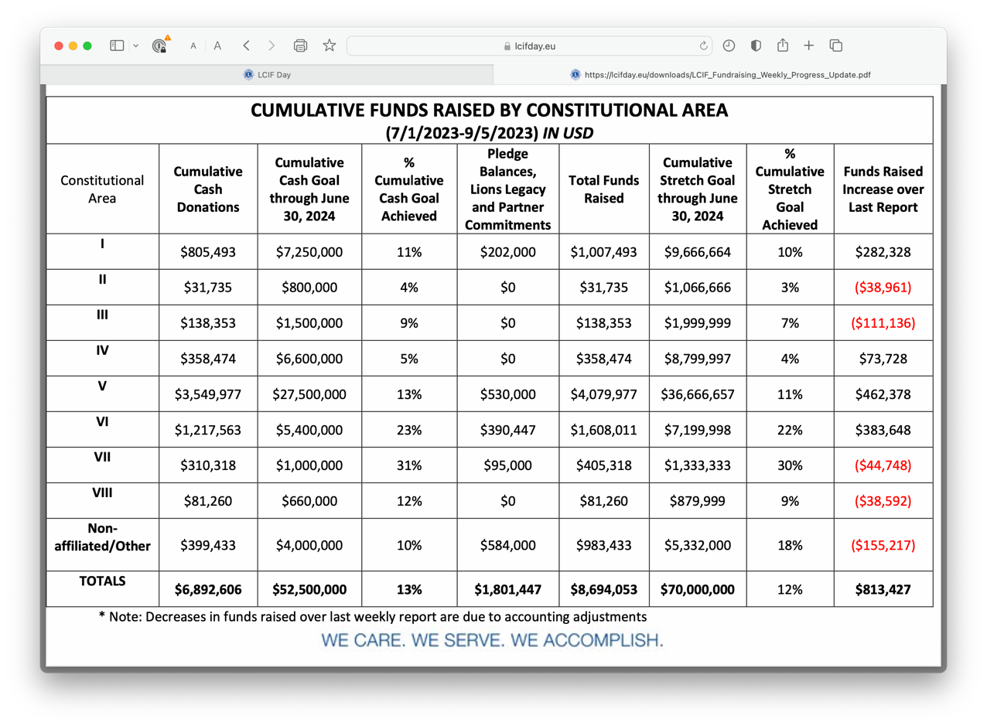

Slide 23
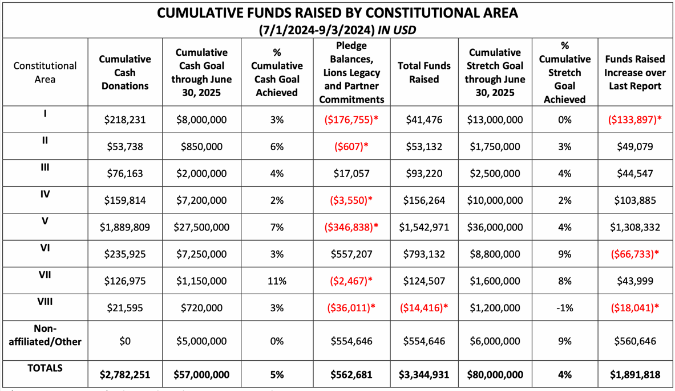

Slide 24
Monthly Reports
(from 2023 training – Information will be updated)
Each month, Donor Services sends an email including the following reports:
MJF/PMJF listing
Status of installments
Recap of donations
Reports are sent after the close of the previous month
Questions on this report can be sent to donorassistance@lionsclubs.org
24

Slide 25
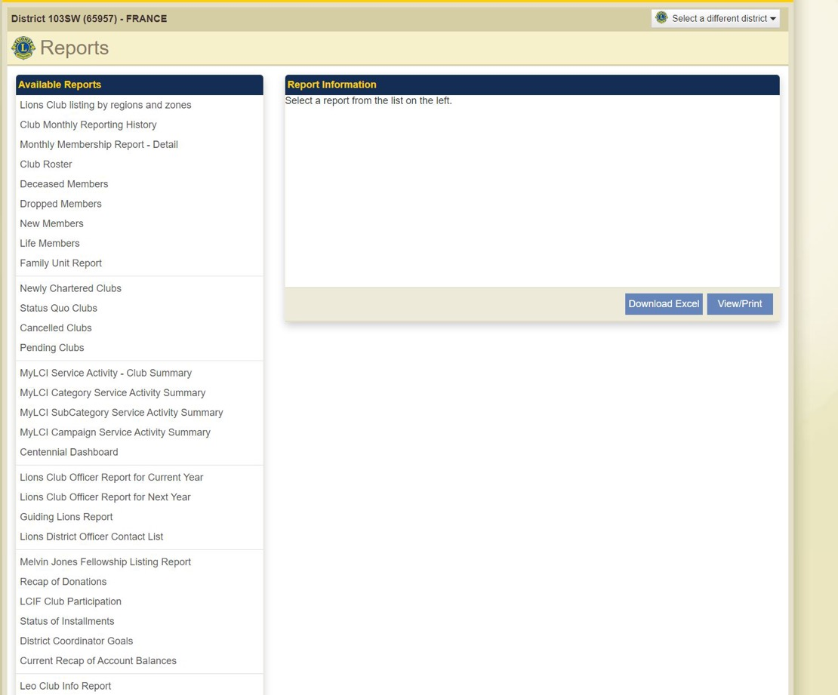
Previously on MyLCI:
Selection of reports
New access to reports yet in development

Slide 26
Recap of Donations
(from 2023 training – Information will be updated)
Totals reset every July 1
Reflects donations, not MJF credits
Only counts donations processed by LCIF (not in the Queue)
This report is useful to track:
Progress toward 100% Contributing Member for clubs
Donations by club, districts or multiple districts
Notes:
Oral comments???
Some additional important points include:
• This report clears after June 30 each year and restarts at $0 on July 1.
• This report is not an accounting of credits toward Melvin Jones Fellowships, it reflects donations
and transfers of donations received within the designated fiscal year.
• This report is a useful tool in tracking 100% Contributing Member status or simply tracking
donation totals by club, district, or multiple district.

Slide 27
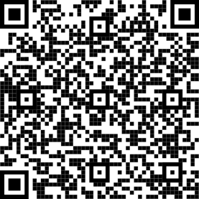
Status of Installments
(from 2023 training – Information will be updated)
MJF or PMJF recognition applications are here: https://www.lionsclubs.org/en/give-how-to-give/melvin-jones-fellowship
Member credits cannot be transferred to a club without written authorization provided to Donor Services.
A club cannot combine credits with a member’s credits to give recognition without that member’s written consent.
Notes:
Αλσο: How To Access Reports On MyLCI
Τηισ ισ τηε ονλινε αππλιχατιον. Λετ’σ ινχλυδε ιτ ασ ωελλ. Ιτ ωιλλ βε γοοδ το ταλκ αβουτ: ηττπσ://λιονσχλυβσ.ϕοτφορμ.χομ/212553776499875?λανγυαγε=εν
• Ωηεν Λιονσ qualify for an MJF or PMJF they can access the application at this address on LCIF’s website:
• Clubs and Districts must also use the application to also request recognition
• Individual member credits are not transferrable to the club without written authorization
provided to LCIF Donor Services
• A club cannot complete an individual’s fellowship by combining club credits and personal credits
without the individual’s authorization provided to LCIF Donor Services
Basically, only the person or institution holding credits may give permission for those credits to be used.

