Slide 1
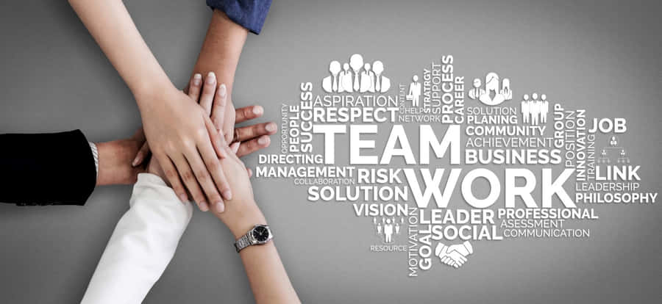
Teamwork
Paul Steele
Development Manager: Europe & Africa
Notes:
We’ve just conducted a team exercise, so this is a good time to consider the ways teams work together.
My first questions for reflection are:
Did your team accomplish its task?
Did your team work well together?
Are you satisfied with the role you played in your teams’ product and efforts?

Slide 2
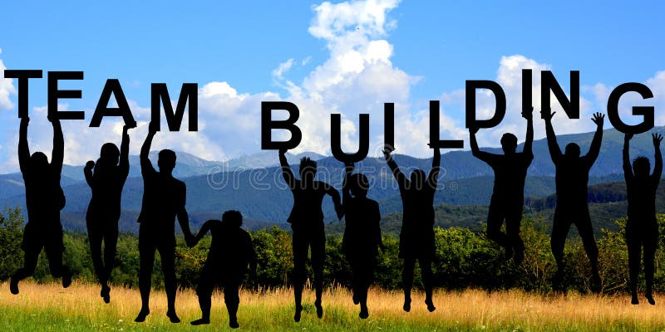
Teamwork
Forming
Storming
Norming
Performing
Notes:
These are the four stages of team performance according to research called the academic research called the Tuckman Model.
Many of you may already have heard of this model. For the purposes of this exercise, I will provide a short description of each stage and ask you to consider:

Slide 3
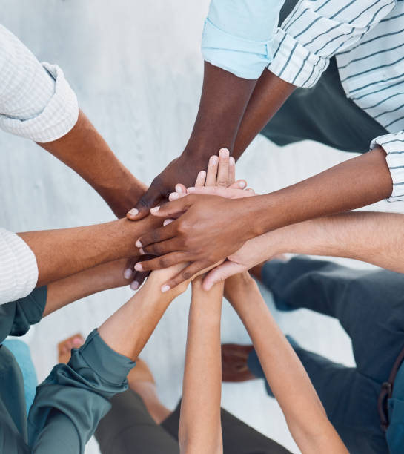
Forming
Team members get to know each other and feel out their roles.
The process is good-natured, and work may be slow.
People avoid conflict, a leader may emerge for guidance.
Notes:
Forming: team members get to know each other and feel out their roles. The process is good natured, but work may be slow. People avoid conflict, a leader may emerge for guidance.
Everyone is trying to be polite!
As you look back on your project, can you imagine what was said and what was done by different people at this stage? Do you remember how you felt?

Slide 4
Storming
Differences may come to light in:
Approach
Agendas
Priorities
Visions
Notes:
Storming: Differences in approach, agendas, and priorities may come to light.
Contrasts in these areas can lead to conflict and inefficiencies. Because understanding those approaches is how you create individual leadership in a group setting. The realization of these differences means that most peoples’ concept of the project must change. There may be some negotiations or clarifications that allow people to become comfortable with changing their understanding of the project.
Not every team reaches this stage.
Did your team reach this stage?
Can you imagine things that were done and said that demonstrate this stage? Do you remember how you felt?

Slide 5
Norming
Members of the team recognize each other’s strengths and agree on a process.
A shared strategy emerges.
The team goal become clear and accepted.
Notes:
Norming: A direction becomes evident as members of the team begin to recognize each other’s strengths and agree on a product and a process. Agreements and shared strategies emerge, and the team goal become clear and accepted. Production usually begins here, with everyone having the same direction. It can start slow and increase in pace as team members become comfortable.
Not every team reaches this stage?
Did your team reach this stage?
Can you imagine things that happened and that wre said that demonstrate this stage? Do you remember how you felt?

Slide 6
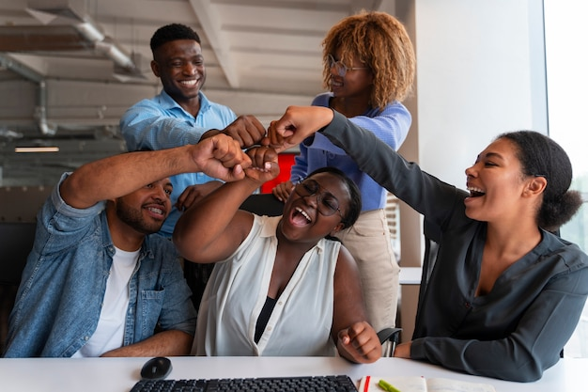
Performing
The team is performing with high efficiency and productivity.
Leaders become less significant as the understood approach creates independence.
The group establishes quick ways to resolve questions that arise.
Notes:
This stage is defined by the efficiency and independence that clarity and confidence bring.
The entire team is working toward the same goal. People trust each other, so share questions and opinions, and make decisions in the spirit of the agreed upon direction without the need of a leader without effecting continuity of the project.
Not every team reaches this stage!
Did your team reach this stage?
Can you imagine things that happened and said that demonstrate this stage?
Do you remember how you felt?

Slide 7
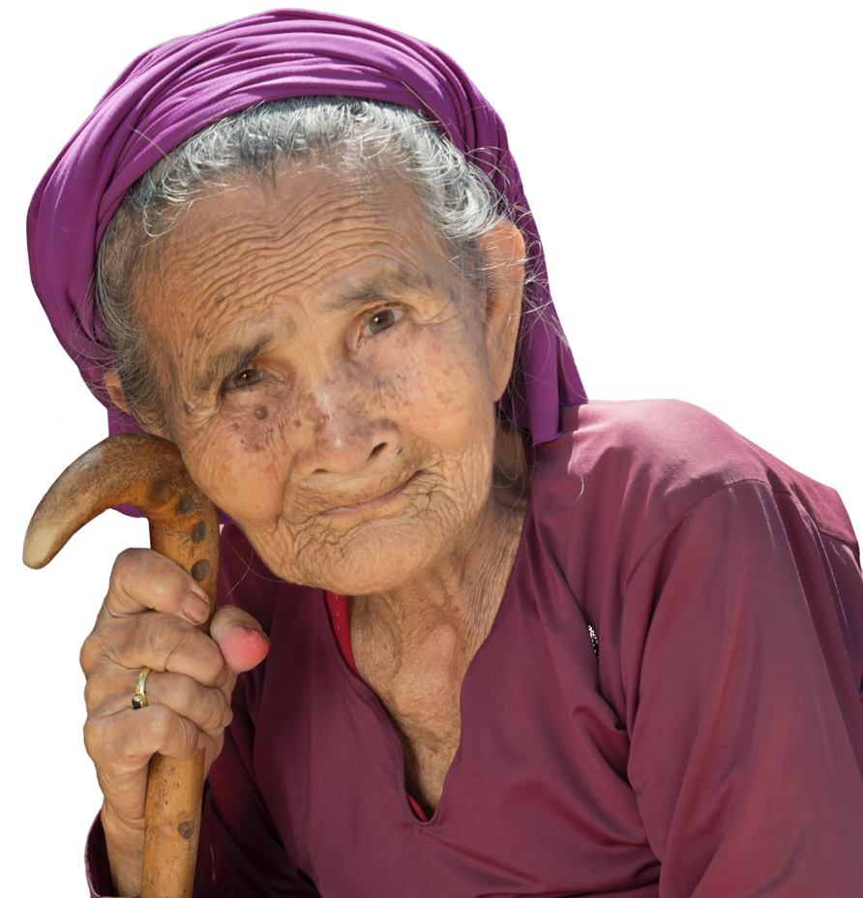
Reflection Questions:
How did your team transition from one stage to the next?
What stage did your team reach in the progression?
Forming
Storming
Norming
Performing
Notes:
Not every team progresses through every stage.

Slide 8
Teamwork
Forming
Storming
Norming
Performing
Notes:
Teams that have moved through these stages before, can do so again, so if your team has not reached the Performing stage in the past, I hope that this was a good opportunity.
Studies show that changing a single member of a team can send a team back to the beginning of this journey, so for our leaders, remember that the process of stabilizing and supporting your team will always begin again.

Slide 9
Consolidation
What personal goals and challenges are important to you?
Are there themes in your team?
Are there any unique issues?
How many teams are you working with?
Did this activity inspire other thoughts, ideas or learning?

